Slide 1
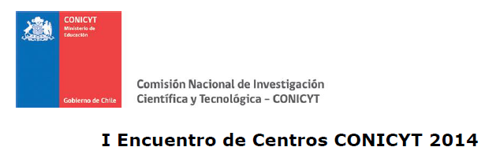



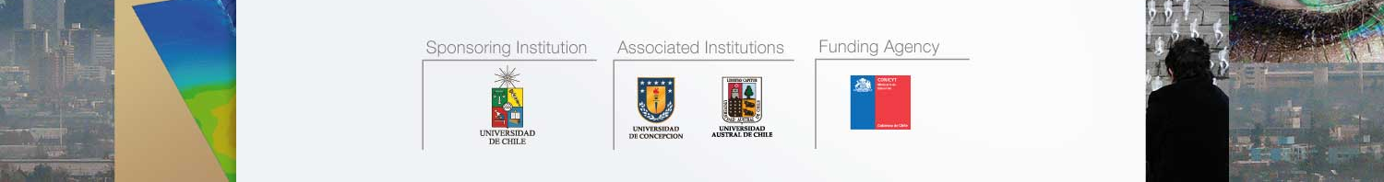
Visibilidad nacional e internacional:
lo obvio y lo sutil …el caso del CR2
Laura Gallardo Klenner
laura@dgf.uchile.cl
CONICYT/FONDAP/15110009
@CR2_uchile
http://www.cr2.cl/

Slide 2



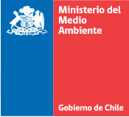

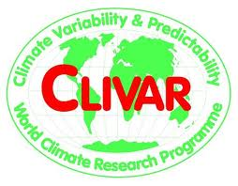





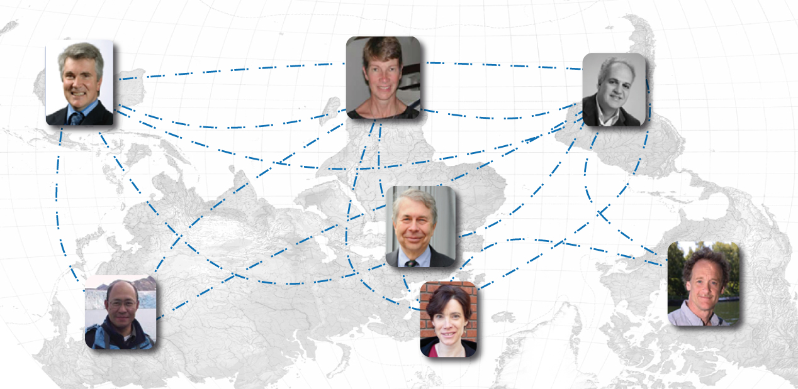









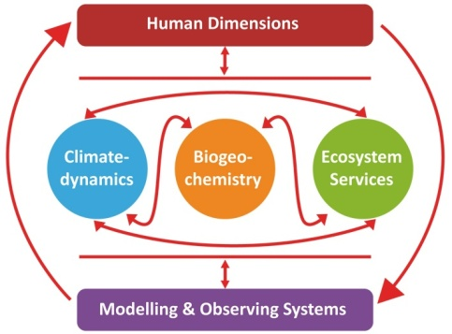



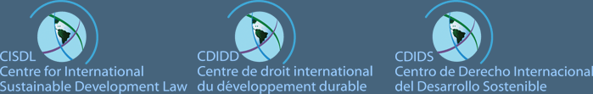


Networking
M. Howden
M. Scholes
Carlos Nobre
G. Brasseur
D. Battisti
T. Zhu
K. O’Brien
Notes:
Global change science is inherently international. (CR)² associate researchers have a distinctive record of collaboration with counterparts abroad as shown in joint projects and papers, and as participants in international committees and scientific bodies.
This is also reflected in the interest and enthusiasm we found when asking leading scientists around the world to collaborate with us as members of our international Advisory Panel, or Scientific Panel, and our International Network of Collaboration.
We are very proud to count in our international Advisory Panel, in alphabetical order:
Dr. David Battisti, Tamaki Chair and Professor of Atmospheric Sciences, University of Washington, USA.
Dr. Guy Brasseur, Director of the Climate Service Center, Germany
Dr. Mark Howden, Theme Leader - Adaptive Primary Industries, Enterprises and Communities, CSIRO, Australia.
Dr. Carlos Nobre, Instituto Nacional de Pesquisas Espaciais, Centro de Ciência do Sistema Terrestre (CST), Brazil
Dr. Karen O'Brien, Professor at the Department of Sociology and Human Geography at the University of Oslo, Norway
Dr. Mary Scholes, Professor in the School of Animal, Plant and Environmental Sciences and Assistant Dean for Postgraduate Studies in the Faculty of Science, University of the Witwatersrand, South Africa.
Dr. Tong Zhu, Chair Professor of Environmental Sciences, Cheung Kong Scholar Program at Peking University, China.
In addition of being world scientific leaders in their fields of expertise in natural and social science, they all have a vast experience in interdisciplinary research, and they act as advisors for policy makers at the highest levels in their own countries and internationally. They have kindly committed to provide guidance to our leading team of principal investigators, to promote collaboration between (CR)² and other centers around the world, and participating in our annual meetings, and in activities involving students and stakeholders.
Also, we have decided to establish a National Advisory Panel, or Policy Panel, where representatives from the Ministry for the Environment, the Chilean Meteorological Office, Water Regulatory Commission, and other relevant stakeholders, including the private sector, are represented. Representatives from the United Nations Development Programme (UNDP), and from the Economic Commission for Latin America (ECLAC) might certainly contribute to this Panel. The purpose of this panel will be to promote the required dialogue between scientists at (CR)² and policy making. It is worth pointing out that among our associate researchers, we count with Ana Lya Uriarte who was the Minister for the Environment between 2007 and 2010. Also, Dr. Jorge Carrasco from the Chilean Weather Office participates in the center as an adjoint researcher.
Regarding institutional collaboration abroad, we have established agreements trying to attain a balance among the different research areas represented at (CR)² and privileging centers where interdisciplinarity is cultivated. Also, we have prioritized institutions with whom short- to mid-term exchanges of students, post doctoral fellows, and researchers could be attained or with whom we can submit joint applications to other funding agencies.
Also, we have been keen at establishing collaboration agreements with existing centers of excellence:
The Center for Mathematical Modeling (CMM) and the National Laboratory for High Performance Computing (NLHPC), with whom we have common interests in applied mathematics, particularly inverse modeling and data assimilation, and in the use and development of high performance computing. This collaboration is fundamental for the work on modeling and observing systems, and it offers a win-win situation for both centers as on the one hand, it reduces substantially the costs in infrastructure for (CR)², and it impinges new momentum to the activities carried out at CMM and NLHPC.
The Andean Geothermal Center of Excellence (CEGA) with whom we foresee cooperation regarding volcanic plumes of oxidized sulfur and halogens, and the use and development of geochemical and isotopic analysis facilities.
The Center for Oceanographic Research (COPAS) will complement the development and establishment of observational capabilities in the coastal ocean, as well as share students and post doctoral fellows.
Also, we have established a cooperation agreement with the Center for Energy (CE) at the Faculty for Physical and Mathematical Science, University of Chile. CE encompasses expertise on energy systems, with emphasis on renewable energy. Moreover, CE is the coordinating body for the "Mitigation Action Plans & Scenarios (MAPS)" project conducted by the Ministry for the Environment.

Slide 3
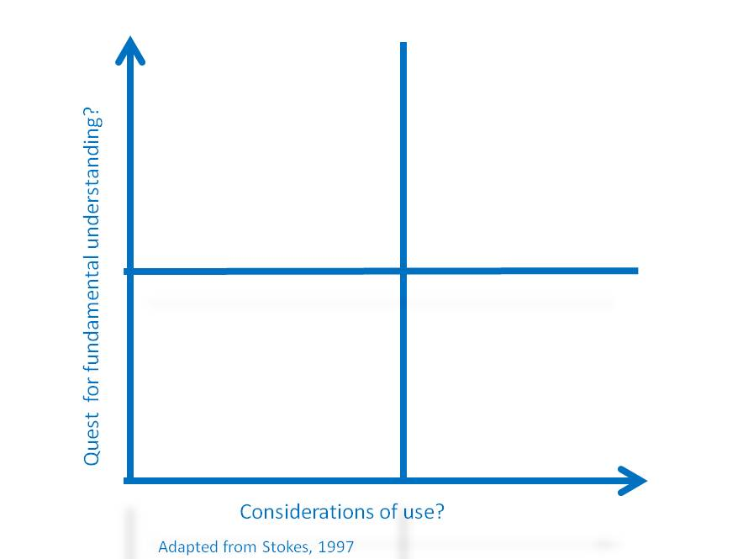

Desde dónde nos vemos
Buscamos nuevo conocimiento y que éste sea usable/aplicable
Hay que disponerse a las interfases
Si se está en el cuadrante de Pasteur, entonces requerimos comunicación y visibilidad

Slide 4
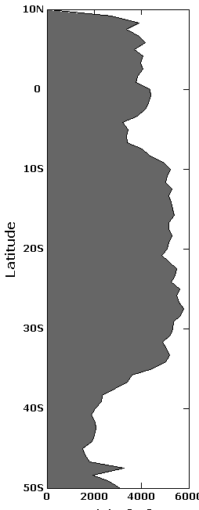

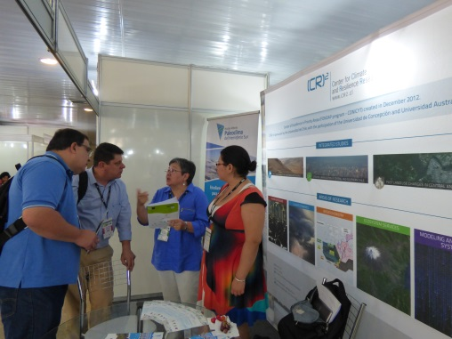
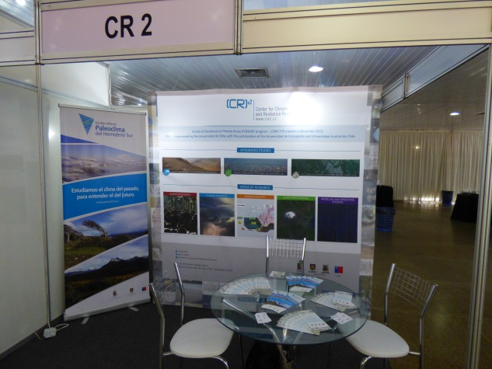

Visibilidad (inter)nacional
Plantear preguntas y problemas de relevancia (inter)nacional
Encontrar nichos de especialidad
Hacerse presentes y comunicar

Slide 5
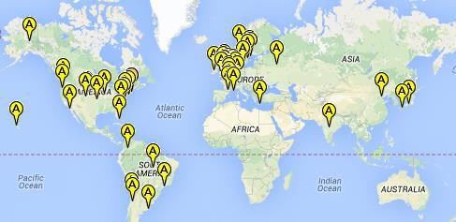
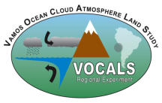
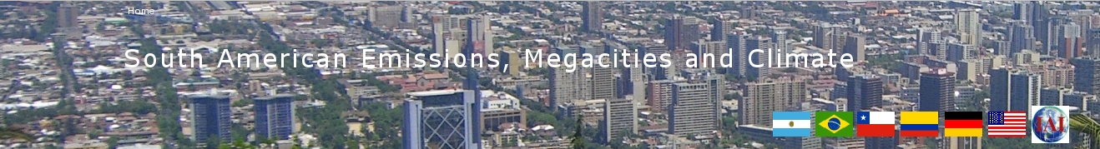
La visibilidad internacional se construye a lo largo del tiempo
La mayoría de nuestr@s investigador@s hicieron sus PhD en ultramar (EEUU, Europa, Oceanía…)…también hay estudiantes allá
Much@s hablamos dos y más idiomas
Vari@s hemos participado en diversos comités internacionales
Y en general, mostramos publicaciones conjuntas con autores de otros países…y asistimos y organizamos conferencias internacionales

Slide 6
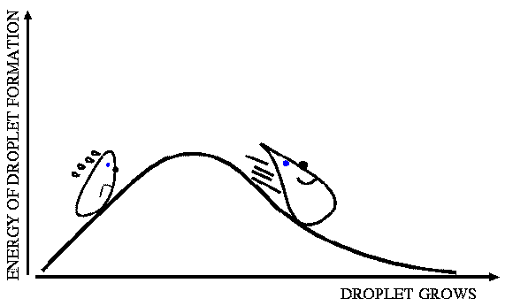
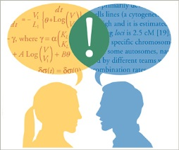

La visibilidad nacional también se construye a lo largo del tiempo
Hay que sobrepasar barreras: escalas de tiempo, incertidumbres, etc.
Algun@s de nuestr@s investigadores han trabajado en oficinas y agencias…o en colaboración con ellas
Algun@s hablamos ambos idiomas…
Co-laboramos sobre una base de entendimiento y respeto mutuo
Somos tomadores de decisión y tenemos intereses («stakeholders»)
Y hay que tener «paz-ciencia»

Slide 7
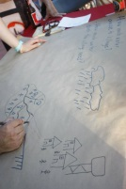
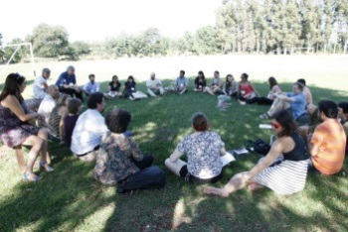
Dedicación y profesionalización
Hay que dedicar recursos humanos especializados
  Luz María Fariña, periodista
  María Isabel Guerra, ing. Civil industrial
  NN…facilitadores

Slide 8
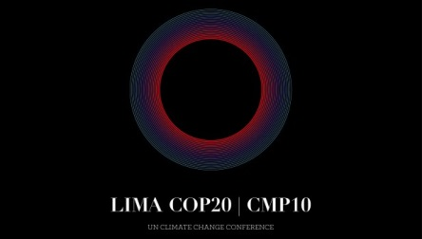

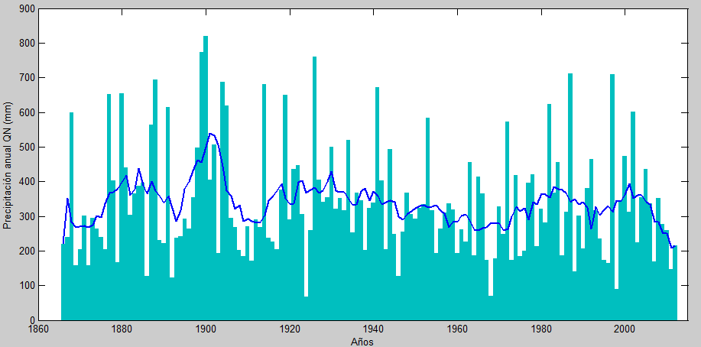

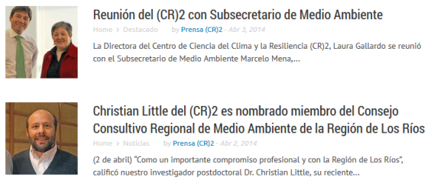
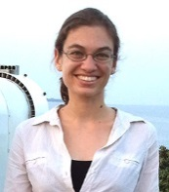

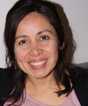
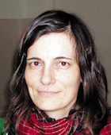
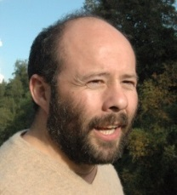
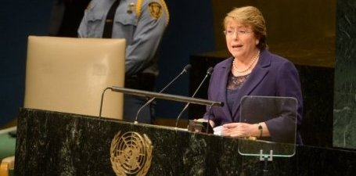
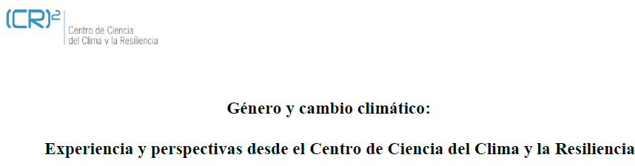
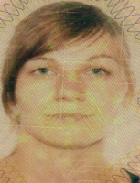
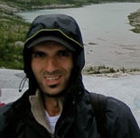


Algunos logros
Megasequía: causas e impactos
Post doctorandos

Slide 9
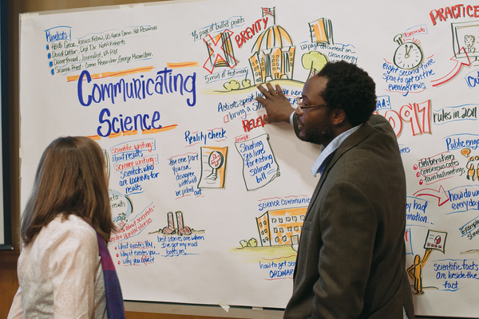
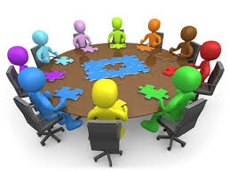
¿Qué falta?
Instancias formales de intercambio y comunicación…
mediadas profesionalmente…
El aparato del Estado requiere coordinarse y reconocer sus centros
Recursos centralizados de comunicación de ciencia

Slide 10
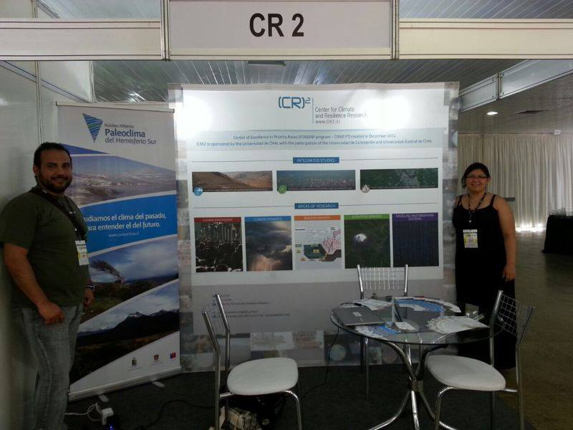
Gracias
laura@dgf.uchile.cl
http://www.cr2.cl/
Centro de Ciencia del Clima y la Resiliencia CONICYT/FONDAP/15110009

