Slide 1



Center for Mathematical Modeling
Universidad de Chile
An international unit of the
Centre National de la Recherche Scientifique, CNRS

Slide 2
Key Figures Mathematics
ISI 10 years

Slide 3

Key Figures Mathematics ISI 10 years
 | Math. Professors | PAPERS | CITES
CHILE | ≈250 | 2100 | 8977
CMM | 42 (17%) | 854 (41%) | 4600 (51%)
Co-authorship CMM
TOTAL | 95%
International | 70%
National other institutions | 43%

Slide 4
Some numbers 2013
42 | Researchers (32 from U. de Chile and 10 from U. de Concepción)
2 | Researchers from CNRS and Université Paris 6
10 | Scientists
24 | Research engineers
11 | Staff (administrative, lawyer, journalist,designer)
80 | Visitors
10 | Postdoctoral fellows
50 | Ph.D. (U. de Chile + U. de Concepción)
3500 | Undergraduate engineering students
6+12+6 | External Associated Researchers UAI + UTFSM+UAB
5 | International conferences
10 | Workshops
2 | Schools
75 | Periodic seminars
2 | Patents

Slide 5
Director
Executive Committee
Scientific Committee
Industrial Board
Principal Investigators
Lab. n
Director
Professionals
Lab. 1
Director
Professionals
…

Slide 6
Scientific Committee
John Ball (President), Oxford University.
Jean Bertoin, Universität Zürich.
Luis Caffarelli, University of Texas.
Ivar Ekeland, University of British Columbia.
Martin Gröetschel, Tech Universität Berlin.
Masayasu Mimura, Meiji University.
Olivier Pironneau, Université Paris VI.
James Yorke, University of Maryland.
Industrial Board
Yuji Inoue, Toyota TIC, NTT, Japan
José Luis Daza, QFR, USA
Maurizio Arienzo, Nova Ware, USA
Alvaro Fischer, Fundación Chile, Chile

Slide 7
Laboratories
Fundamental
Research
LBMG
GeoM
Net-Eco
Education
HPC
LM4
———
Stochastic Simulation
BioProcess
Image-Analysis
Planning-Logistics
Astro-Informatics
Industry/sector Sec
Mining
Telecom
Energy
Water
Biotechnology
Environment
Education
Optimization
Stochastic Modeling
Nonlinear Analysis
Discrete Mathematics
Math. Mech. & Inv. Prob.
Numerical Analysis

Slide 8
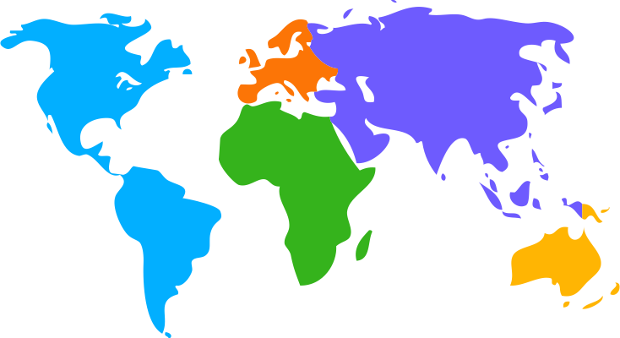

International Network Centers
Latin America
  Brazil (IMPA, USP)
  Mexico (CIMAT, CINVESTAV)
North America (Brown, UC Davis, IMA Minneapolis, IBM-Watson, MSRI Berkeley, PIMS)
Europe (BCAM, U. Cergy Pontoise, École Central, École Polytechnique, ICMAT, Paris VI, Paris Dauphine, Paris Math Foundation, Matheon Germany)
China (Shanghai JiaoTong, Peking
Japan (Tokyo, Kyushu, Meiji, NTT, Toyota)
Singapore (NUS, Nanyang)
Australia (NewCastle U. , Ballarat)
Chile (AURA, ESO, F. Chile)
Supporting similar Centers in Peru, IMCA, Ecuador MODEMAT, Colombia U. Nacional, Paraguay
Text
Text
Text

Slide 9
Associated Institutions and projects
CNRS Mathematics, Informatics and Engineering
INRIA : Bioinformatics, Bioprocess, Energy
Innova CORFO- Aquiculture, Geomechanics
National Cancer USA
ECOS, MathAmSud, STICAmSud
European Projects. Energy
Soros’s Foundation
Text
Text
Text

Slide 10
Yearly average budget US$ 10,000,000

Slide 11
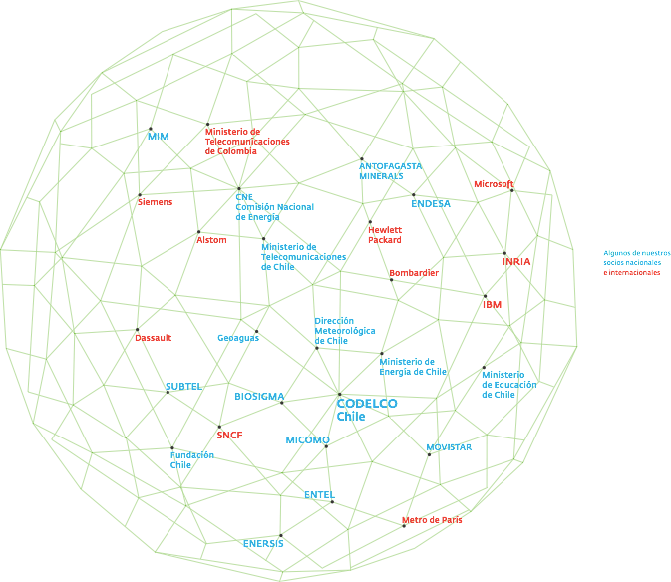

Slide 12

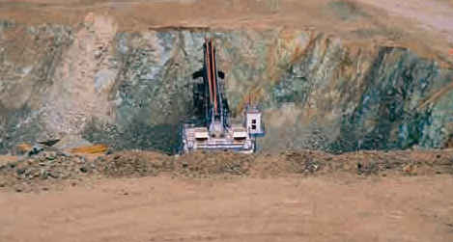
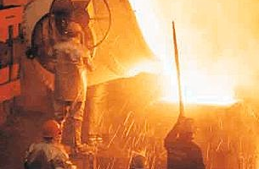
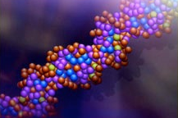
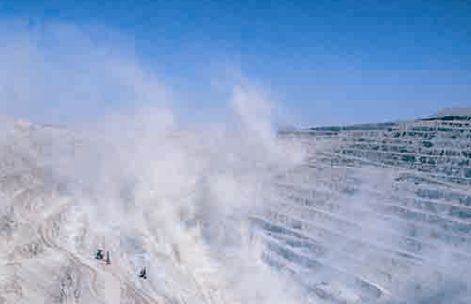
Mining
Bio-mining and Genomics-BioSigma
Rock-blasting in Mine Excavations- ET
Mine Planning- ET and ES
In situ leaching- Chuqui- ES
Risk Analysis -New Level Mine -ET
Stochastic Simulation-Seismicity- Micomo, ET
Intelligent geo system for mining GeoAlert. BHP
Real Time Mining

Slide 13
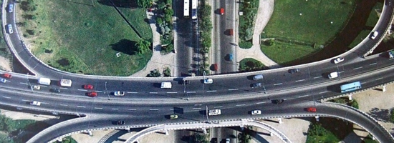
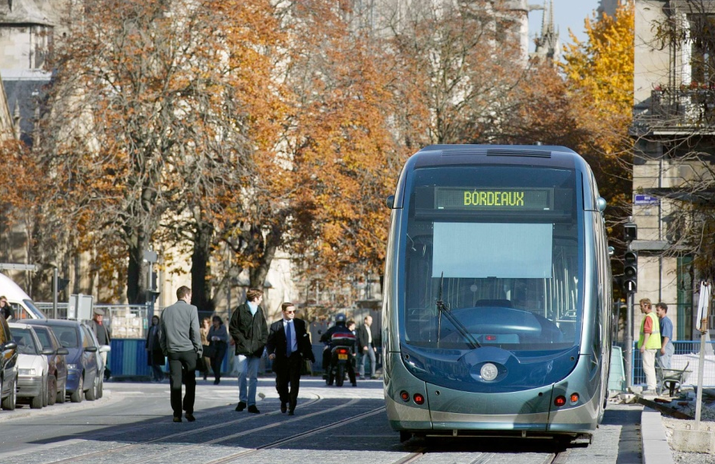
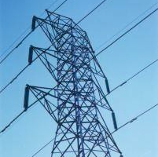

Networks Economics
Transport Cargo trains
Energy and Networks
Optimization and Equilibrium in the Telecommunications Market
INTEGRAIL (Intelligent integration of Railway Systems) European project
Modurban (Modular Urban Guided Rail System) European project
Water Tariffication!

Slide 14
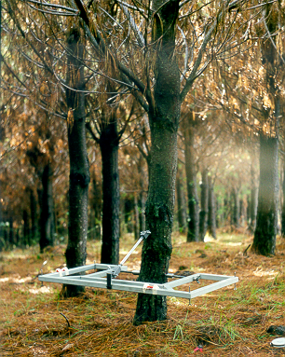
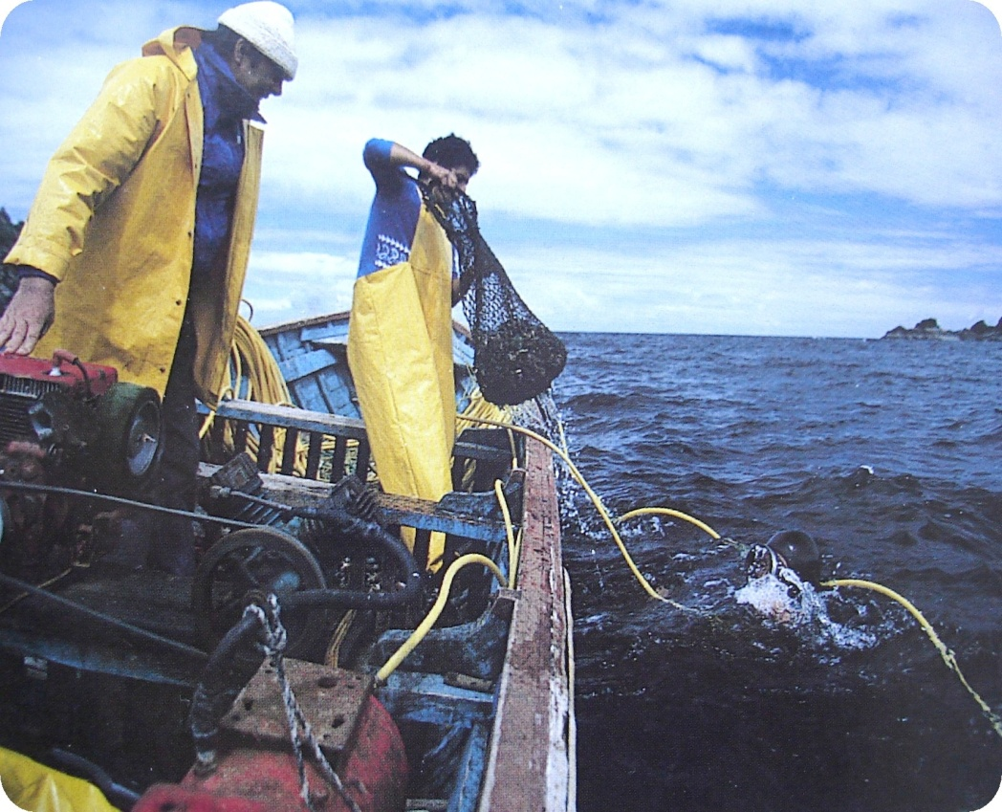
Renewable Resources
Salmon Genome Consortium
Grapes and wine. Logistic and bioinformatics. Wineries.
Management of Fishery Resources, IFOP.
Control and Optimization of BioProcesses: Applications to Waste-Water Treatments. INRA.

Slide 15
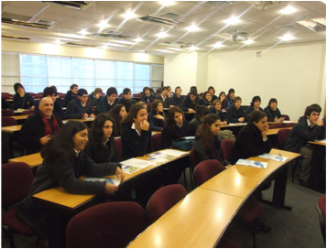
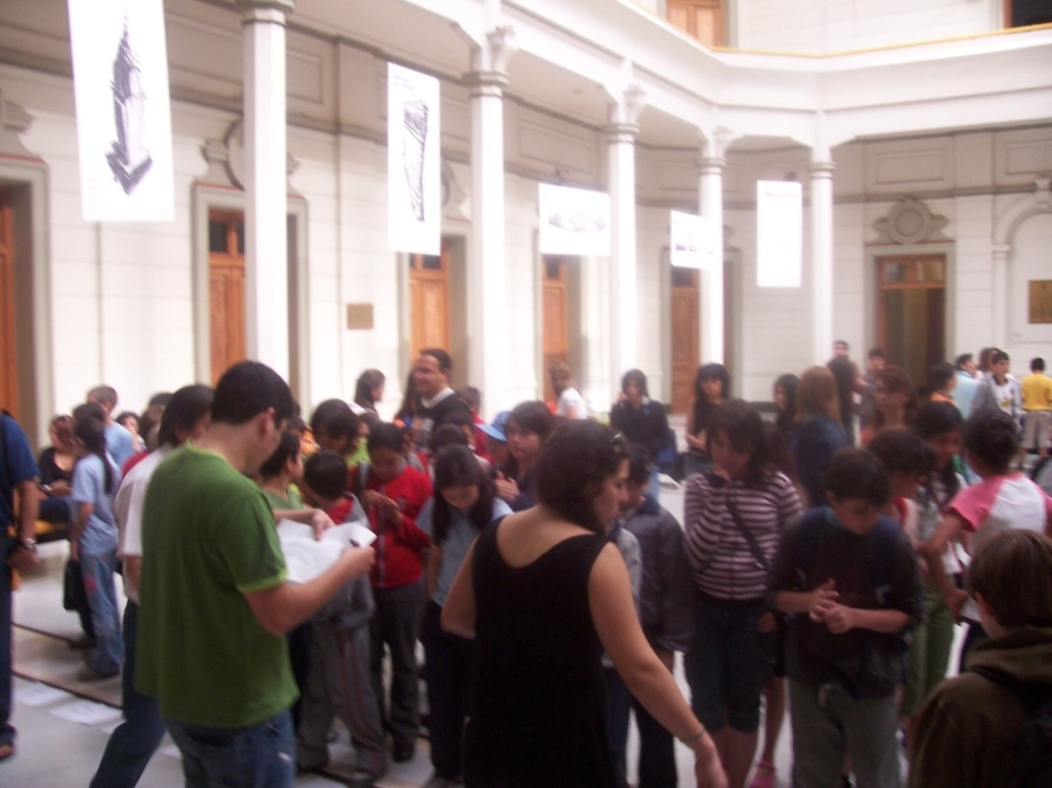
Education
To contribute to mathematics education of children through long term, national efforts:
Elaboration of National Standards for the Preservice Elementary and High School Teachers.
Materials (books and Audiovisual) for Preservice Elementary and High School Teachers
Inservice Teachers Training in Mathematics
Research Seminar in Teaching and Learning School Mathematics and Math Tournament for School Students (with USACH
Collaboration with Ministry of Education, CIAE, Universities at national level, Michigan State University, Texas University, University of Helsinki, NIE Singapore.

Slide 16
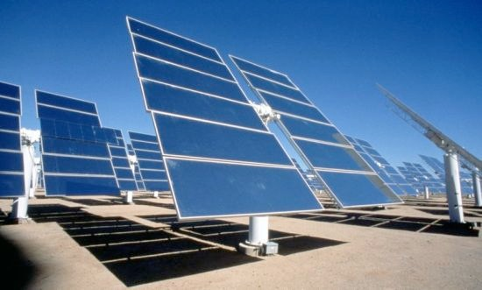
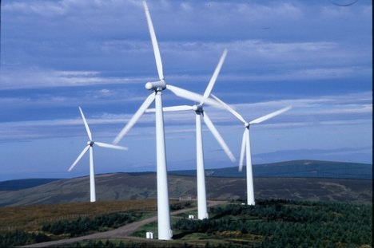
Energy spin off
Smart grid
Risk Analysis of network and generation failures
Renewal -micro generation
FONDAP--> CMM and CDEC-SING ---> HPC

Slide 17

Environment spin off
Environmental Modeling with Emphasis on the Dispersion of Atmospheric Tracers and their Impacts
South American Emission, Megacities and Climate
FONDAP --> CMM

Slide 18

INRIA initiative
INRIA France
Technological Transfer
Energy, Bioinformatics, Natural Resources
CORFO grant supporting INRIA-Lab in Santiago-10 years project

Slide 19

The NLHPC project
To establish a high performance computing (HPC) capacity in Chile, making it available to all research groups in the country and to promote its use in the large and multi scale problems of Chilean industry
Connectivity and cooperation !
Near 100 research groups associated to NLHPC

Slide 20
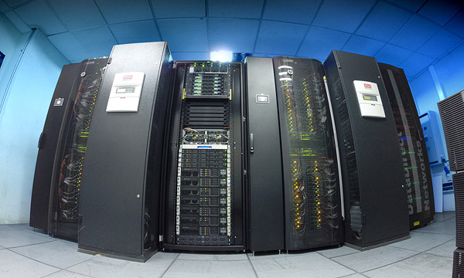
The NLHPC project
Leftraru
128 Nodos HP SL250,
2640 cores
12 Xeon Phi 5110p
274TB de almacenamiento
Competition to use Leftraru
for one month

Slide 21
National initiatives
Ministerios: Educación, Energía, Minería, Telecomunicaciones, Interior
Público: IFOP, INTA, Fundacion Chile, Academia de Ciencias, Colegio de Ingenieros, CMAT, Embajada EEUU, U. Andres Bello.
Centros de Excelencias. Energía, Medioambiente, Centro Genómico, Neuro ciencias, Sistemas Complejos Ingeniería, Biotecnología, Educación, INIA, Neuro Cirujía.
Encuentro Centros de Excelencia
NLHPC
Comisión Presidencial
Congreso del Futuro
Centro de regulación Financiera
Empresas: Codelco, CAP, Escondida, GesEcology, BioSigma, Empresas Salmones, Antofagasta Mineral, CSAV, Viñas, Aquagen, Metro, Ediciones SM, Fundacion Luksik

Slide 22
Gracias

