Slide 1
FRAUNHOFER CHILE RESEARCH
A DRIVER FOR INNOVATION IN LATAM
FROM SCIENCE TO COMMERCIAL VALUE

Slide 2
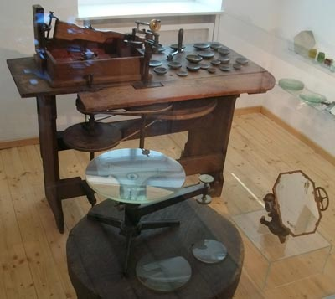
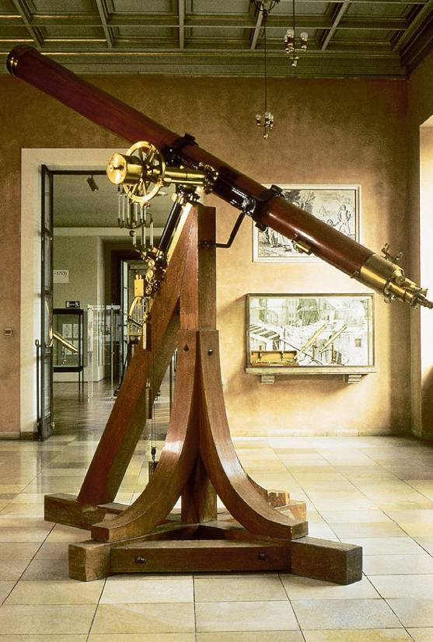
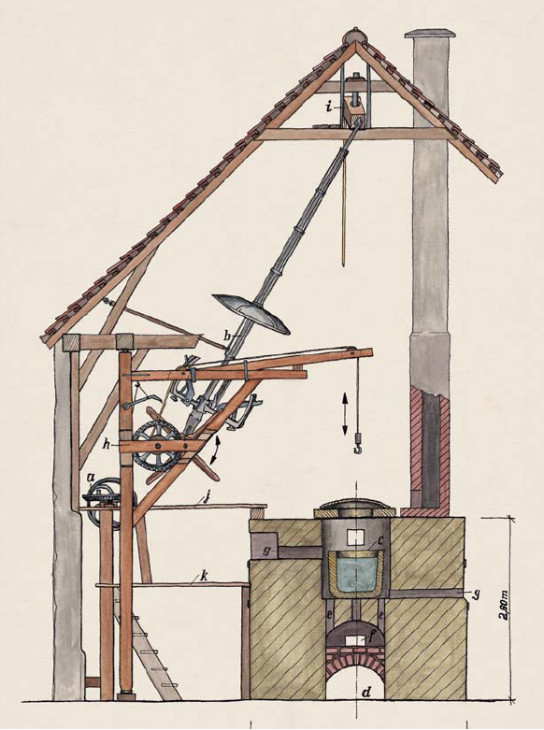
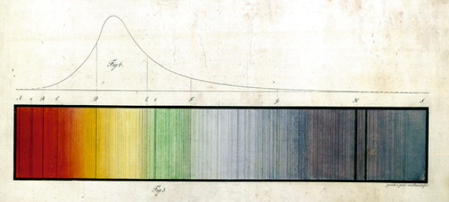
Joseph von Fraunhofer's Vision: ´Being Closer to the stars´
The development of new types of glass, significant improvements in glass manufacturing and the perfection of the construction of optical instruments led to impressive results. Fraunhofer established standardized manufacturing methods, expanded the product range of the workshop significantly and with that increased its economic success.

Slide 3
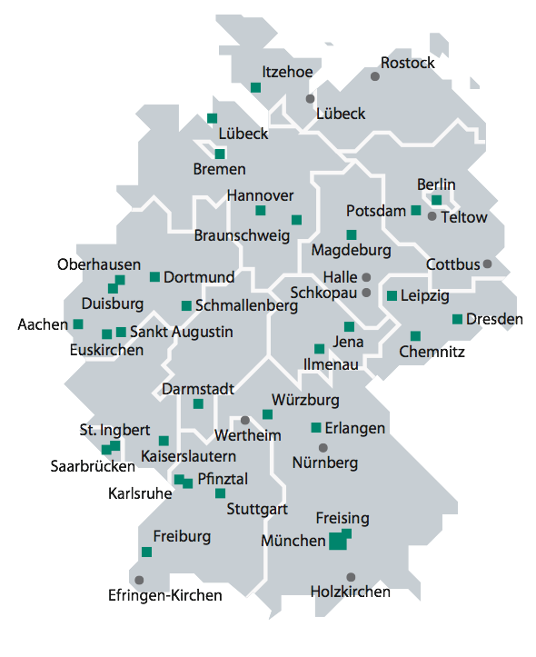
FRAUNHOFER GESELLSCHAFT
Fraunhofer is the largest application-oriented Research Organization in Europe.
Fraunhofer provides research support for new products or services for German Industry
Focus is on practical solutions which impact people:
Health and Environment , Safety and Security, Information and Communication, Transportation and Mobility, Energy and Water
Fraunhofer in numbers
  67 Institutes in Germany
  23. 000 scientists and engineers
  Budget of Euro 2 billon budget
  Euro 1.6 bil from contract research
Fraunhofer helps to implement Government policy on Innovation

Slide 4
FRAUNHOFER GESELLSCHAFT
Fraunhofer Institutes work with small, medium and large companies as well as government
Most Fraunhofer Institutes have pilot plants
Fraunhofer Institutes do not sell products but develop prototypes
Business model is largely via licensing
FhG creates significant economic value for German Industry
FhG scientists file a patent application a day
  This allows value generation via intellectual property rights
FhG creates significant economic value
FhG can also be viewed as an IP management, technology transfer and innovation management organization

Slide 5



Focus on Innovation and Technology Transfer
Methods to accelerate innovations
How good is the innovation ability
of our company?
Systematic evaluation and analysis of the innovation ability
Innovation
Audit
How can we increase the innovation ability of our company consequently?
Continuous steering of the innovation ability
Innovation
Card
How can we accelerate the innovation projects of your company?
Identification, analysis
and overcoming of timedrivers
Timedriver
analysis

Slide 6
Role of Fraunhofer within the innovation system
Societal challenge as future markets - being ready for global competition
Research cycle
Innovation cycle
Universities
perform excellent scientific research
RTOs bridge the innovation gap with technological R&D
Innovative
companies create
new products
Intensive exchange with society
The Management model of Fraunhofer is driven by the intermediary position between science and industry
The Fraunhofer management model needs to foster
  demand driven thinking (close contact to industry)
  ideas and fundamental research (close contact to universities)
  thinking in networks (making new connections)
  thinking in system approaches (Life cycle analysis etc)
Notes:
Message:
A systems approach need to integrate scientific research, technological R&D and innovative companies - RTOs focus on the closure of the innovation gap
-> network R&D acteurs along the value chain of R&D, integrate societal demand and acceptance, align challenges with lead markets
Fraunhofer focus in management model (einzelne Zeilen animiert!):
- demand driven thinking in close alignment with industry as our prime customer (example innovation cluster and intelligent networking)
- ideas and creativity (example future topics; also internal programmes as structural source of ideas)
- utilizing network capacity (within Fraunhofer Internal Programmes, in Spin-off ecosystem or also in international networks)
- system approaches (example electromobility - nobody has a similar potential as Fraunhofer with its wide portfolio)

Slide 7
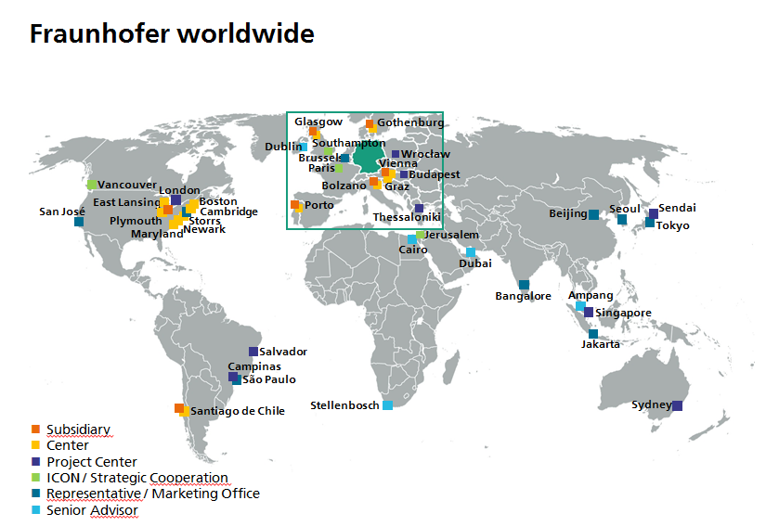

Slide 8
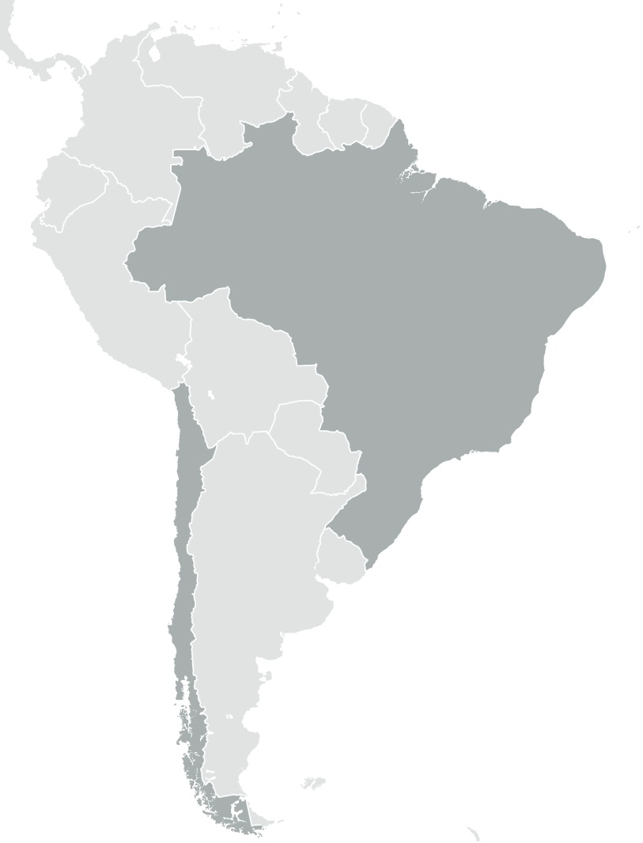
Fraunhofer in South America
Fundación Fraunhofer Chile Research
  Center for Systems Biotechnology
  Center for Solar Energy Technologies
  Project Center InnoCity
Fraunhofer Project Center on Software and Systems Engineering, Salvador
Fraunhofer Project Center for Innovations in Food and Bioresources, Campinas
Salvador
Campinas
São Paulo
Fraunhofer Liaison Office,
São Paulo
Santiago de Chile
Subsidiary
Center
Project Center
Representative / Marketing Office
Notes:
Fundación Fraunhofer Chile Research
Leitung: Dr. Wolfgang Schuch
Die Fundación Fraunhofer Chile Research wurde Oktober 2010 in Santiago de Chile als Stiftung chilenischen Rechts von der Fraunhofer-Gesellschaft gegründet. Die Stiftung betreibt das Fraunhofer Center for Systems Biotechnology, das Anfang Januar 2011 seine Arbeit aufgenommen hat.
Fraunhofer Center for Systems Biotechnology
Die Ziele des Fraunhofer Centers for Systems Biotechnology (Leiter: Dr. Wolfgang Schuch) in Santiago de Chile sind die Erforschung und Entwicklung von Lösungen im Bereich der angewandten Biotechnologie, die Kooperation mit chilenischen Forschungspartnern und die Ausweitungen der internationalen Industriekontakte der Fraunhofer-Gesellschaft.
Gemeinsam mit chilenischen Partnern werden verschiedene Technologien ent-wickelt und optimiert: Durch Schnelltests zur frühzeitigen Erkennung von Fischkrankheiten oder die Entwicklung von Impfstoffen für Lachse sollen die Erträge von Aquakulturen verbessert und sicherere Produkte bereitgestellt werden. Besondere Nanotechnologien sollen helfen Schadstoffe wie zum Beispiel Pestizidrückstände aus Getränken oder Abwässern zu entfernen. Eine weitere Projektgruppe untersucht die ökologisch optimierte Nutzung von Biomasse zur Energiegewinnung.
Gefördert wird das internationale Exzellenzzentrum durch InnovaChile mit insgesamt 19,5 Mio US$ über 10 Jahre. Das Programm wurde von der staatlichen Wirtschaftsförderungsbehörde CORFO mit dem Ziel ins Leben gerufen, exzellente internationale Forschungsinstitutionen für gemeinsame Forschungs- und Entwicklungskooperationen in Chile anzusiedeln. Die Einrichtung des Fraunhofer Centers wurde aktiv durch die Deutsch-Chilenische Industrie- und Handelskammer unterstützt.
Partnerinstitut in Deutschland ist das Fraunhofer-Institut für Molekularbiologie und Angewandte Oekologie IME mit Standorten in Aachen, Münster und Schmallenberg.
Das Center in Santiago de Chile kooperiert eng mit den beiden renommierten Universitäten Pontificia Universidad Católica de Valparaíso (Biomasse) und Universidad de Talca (Nanotechnologie) sowie der Stiftung Fundación Chile (Aquakultur).
Fraunhofer Project Center on Software and Systems Engineering
Salvador de Bahia, Brasilien; gegründet: 2012
Fraunhofer-Institut für Experimentelles Software Engineering IESE, Kaiserslautern in Kooperation mit der Federal University of Bahia (UFBA)
Gemeinsame Forschungsthemen: Innovative Lösungen für kritische bzw. große Systeme, mobile Geschäftsanwendungen, e-Government sowie Lebensassistenzsysteme (Ambient Assisted Living)
Partner vor Ort ist die Federal University of Bahia (UFBA).

Slide 9


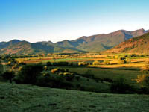

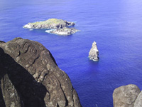

Fraunhofer Chile Research
FCR established in 2010
FCR is the only legal representation of Fraunhofer in Latam
Aim is to bring the Fraunhofer Model to Chile and Latam via close collaboration with German and local Industries
Centre for Systems Biotechnology (CSB) was its first Research Centre
Close collaboration with Fraunhofer Institute for Molecular Biology and Applied Ecology (IME), Aachen
Financing in Chile for 10 years is provided by the CORFO (ICE)
No financial contribution from Germany to Chilean operations
At present more than 120 scientists work in FCR-CSB
2 granted patents, 9 patent applications filed, more being prepared
Raised funding for 20 new projects based on Industry needs
Raised funding for 24 new projects from public competitions
Raised a total of over US$25Mil for new research

Slide 10
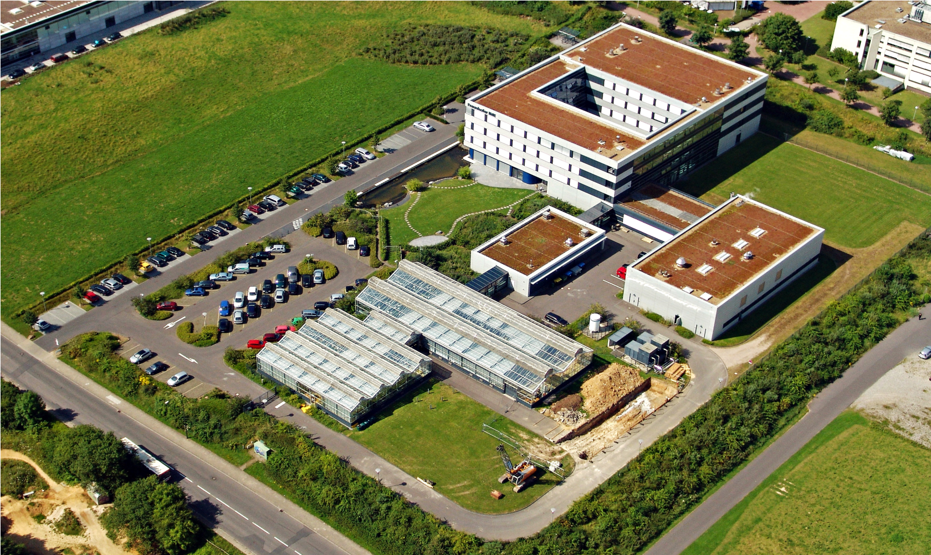
Fraunhofer IME
HQ in Aachen
Director: Prof. Dr. Rainer Fischer
Other sites in
Schmallenberg, Muenster, Giessen, Frankfurt/Main and Hamburg as well as
USA and Chile
Around 350 scientists
Avia-Luftbild, Aachen – Dipl.-Ing. Martin Jochum
Applied Biotechnology, Environmental Services, Drug Discovery and Production

Slide 11







Fraunhofer Chile Research
Fraunhofer IME
Universidad de Talca
Fundación Chile
Pontificia Universidad Católica de Valparaíso
Fraunhofer Chile Research
Pontificia Universidad Católica de Chile
Universidad Andrés Bello

Slide 12
FCR-CSB: OUR RESEARCH LINES
Agriculture
  Pollination research to increase productivity of primary agriculture
  Bee health and bee products to add value to honey producers
Aquaculture
  Vaccines and Therapeutics to protect salmon industry from disasters
  Sustainability to help industry with certification processes
Therapeutic Peptides to generate novel disease treatments
Bio-Computing and Applied Genetics to generate new varieties and
disease monitoring systems based on latest genome research
Renewable Resources to generate value added products and biofuels
Nano‐Biotechnology to remove unwanted chemicals from liquids
Nano-Medicine to deliver DNA/RNA drugs efficiently
Bio-Medicine to develop biomarkers, provide preclinical research services
and develop new drugs for Alzheimers and other brain disorders

Slide 13
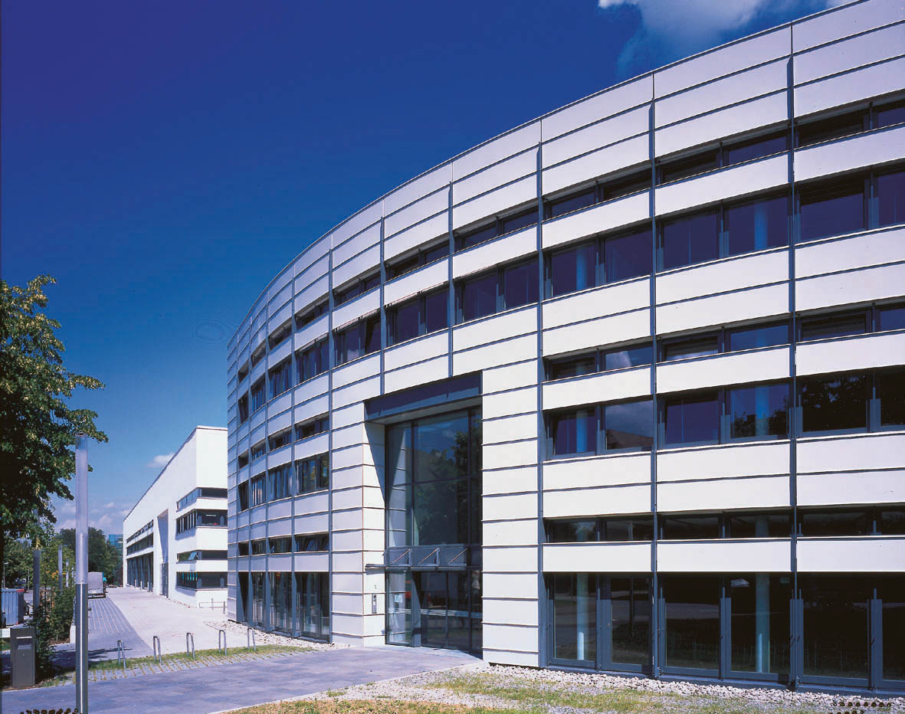
Fraunhofer ISE
Director: Prof. Eicke Weber
HQ: Freiburg
Energy Efficient Buildings
Applied Optics and Functional Surfaces
Solar Thermal Technology
Silicon Photovoltaics
Photovoltaic Modules and Systems
Alternative Photovoltaic Technologies
Renewable Power Supply
Hydrogen Technology
Around 1250 Staff
ISE also provides Certification Services
for Solar Industry

Slide 14

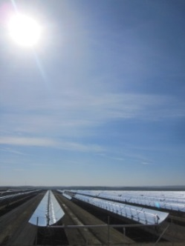
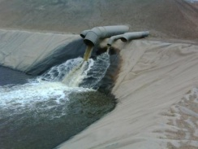
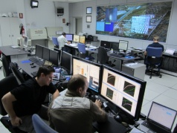
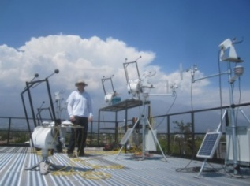
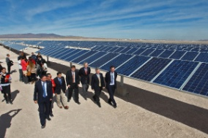
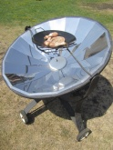
FCR-CSET
Funding from Ministry of Energy administered by CORFO
Contribution to the Development of a Solar Economy in the North of Chile
´Calama Solar´
Solar Power Generation
Solar Process Heat and Cooling
Solar Water Treatment
Poly-generation
Energy System Modeling for Integration of Renewables

Slide 15
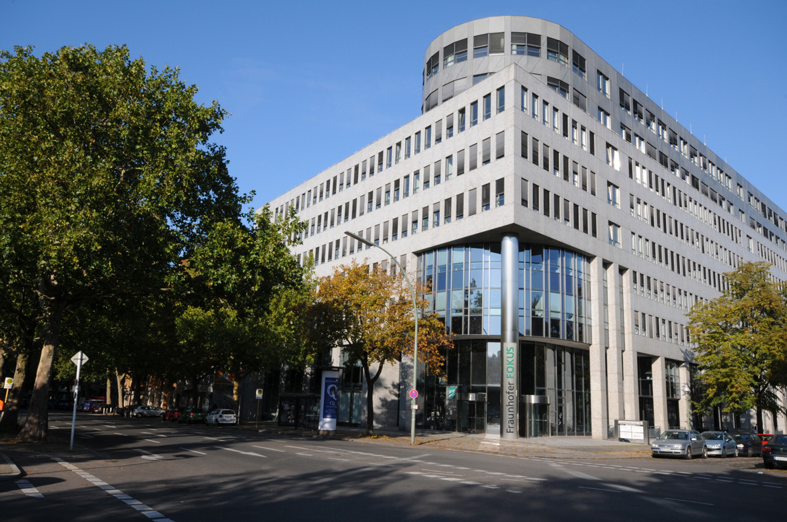
Fraunhofer FOKUS
Director: Prof. Radu Popescu-Zeletin
ASCT
Automotive Services and Communication Technologies
E-HEALTH
Platforms and Solutions for Connected Healthcare
ELAN
Electronic Government and Applications
ESPRI
Electronic Safety and Security Systems for the Public and Industries
FAME
Future Applications and Media
IT4ENERGY
Smart Metering & Energy Management
MOTION
Modeling and Testing for System and Service Solutions
NET
Network Research
NGNI
Next Generation Network Infrastructures, ÖFIT Public Information Technology,
QUEST: Embedded Systems Quality Management, VISCOM Visual Computing

Slide 16

























































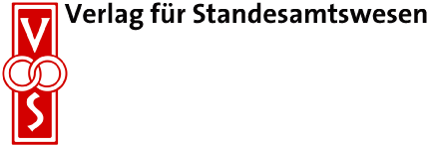






Current Partners of the Laboratory

Slide 17
FCR-InnoCity
In October 2012,established
Fraunhofer Fokus InnoCity as a Hub
for Smart Cities Technologies for
Chile and Latam.
Present Projects in:
  Smart Cities Concepts
  Smart Grids, Smart Electricity
  Smart Buildings and Construction
  Smart Transport and Mobility
  Connectivity
  M2M
  eHealth
ICT Platform also useful for applications in Mining

Slide 18
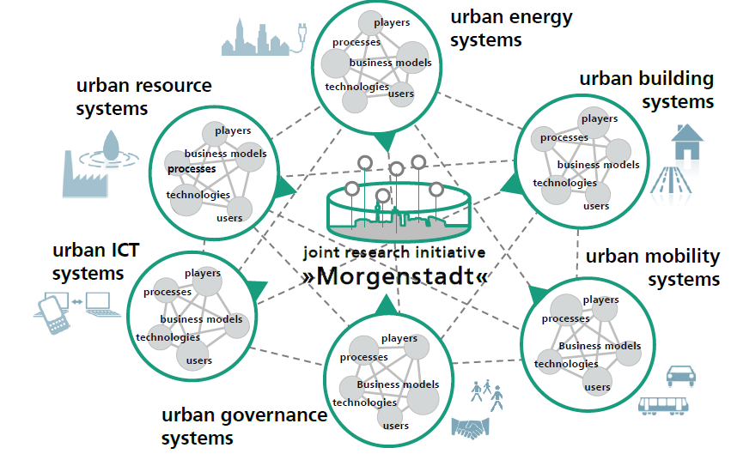
Smart Cities: Urban Systems

Slide 19
Fraunhofer Chile Research
Original Collaboration with U Talca, PUCV and Fundación Chile
Selection based on scientific excellence, an important part of the Fraunhofer approach
Now collaborations with UNAB, PUC, U Chile, USACH, UTM, UDD, UAI, UAndes, Catolica del Norte, UTFSM, U Valparaiso, USACH, San Sebastian, U Concepción, U Austral, UTM, U Los Lagos
Collaborations are all different
Discussion under way with several others Universities
In all collaborations Fraunhofer is not only research partner but also a technology transfer partner
We also want to establish collaborations with Conicyt Centres for the same reasons

Slide 20
Fraunhofer Chile Research
WHAT WE OFFER
Networking services
Consultancy services and Project Evaluation
Project Management
Pilot projects for product and market development
Applied research projects for industries based on our local expertise
Technology Transfer
Patenting services
Fund raising for research projects
HOW TO WORK WITH US
One to one projects
Large scale projects with multiple partners such as Innovation Clusters
Strategic Partnerships
Spin-off company establishment

Slide 21
Fraunhofer Chile Research
WHY FRAUNHOFER IS SO SUCCESSFUL
Alignment with National Policy
Very close relationships with Industry
Very close relationship with national and regional government
Very experienced technical staff
Very high level of instrumentation in Institutes
Pilot plants for small scale production runs
Experience in small scale as well as large scale projects
Experienced legal department for contract development and IP protection
Strong commercial negotiations with industry partners
Experience in delivering contracts

Slide 22

Contact Details
Wolfgang Schuch
Executive Director
Fraunhofer Chile Research Foundation
Mariano Sánchez Fontecilla 310, Piso 14
Las Condes, Santiago, Chile
Wolfgang.schuch@fraunhofer.cl
56 96 597 9364

Slide 23
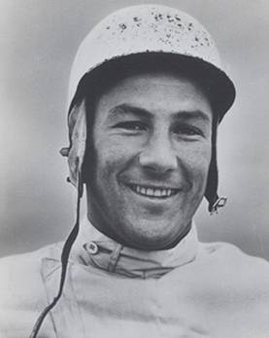
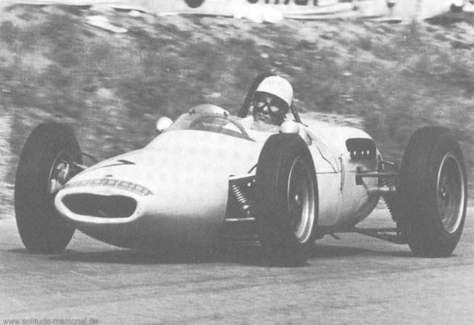
If everything is under control you are just not driving
fast enough.
Stirling Moss
(automobile racer,
born 1929)

