Slide 1
FRAUNHOFER CHILE:
A DRIVER FOR INNOVATION IN CHILE

Slide 2
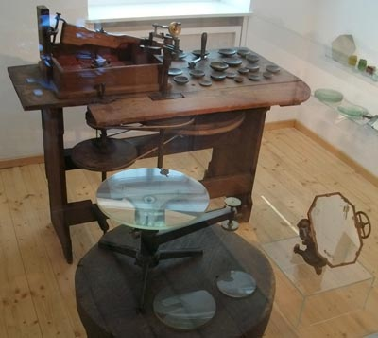
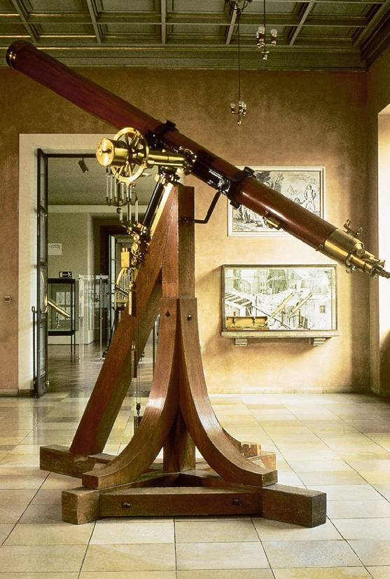
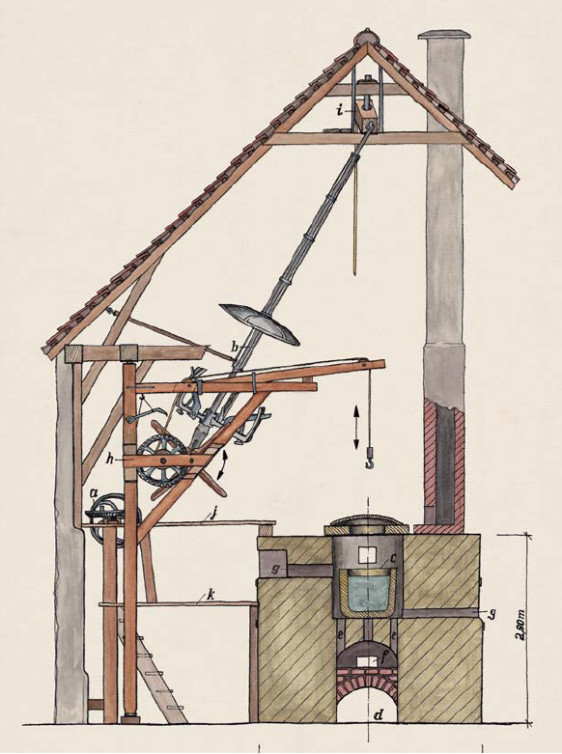
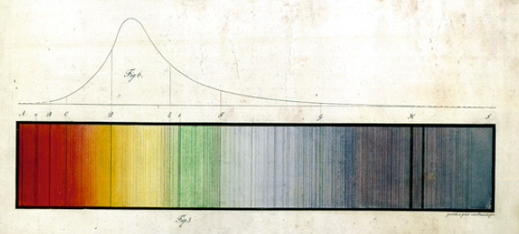
Joseph von Fraunhofer's Vision: »Being Closer to the stars«
Born in 1787, Fraunhofer was self-trained. He developed new types of glass, made significant improvements in glass manufacturing. The perfection of the construction of optical instruments led to impressive results. Fraunhofer established standardized manufacturing methods, expanded the product range of the workshop significantly and with that increased its economic success. He died in 1826.

Slide 3
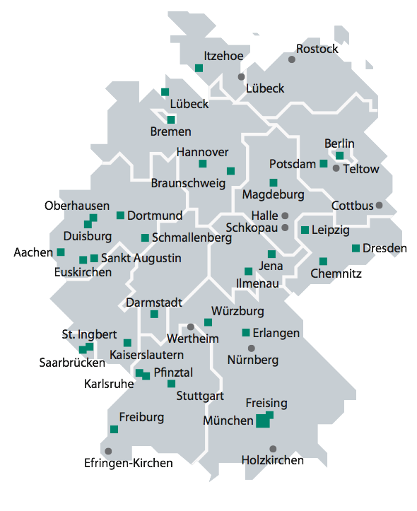
FRAUNHOFER GESELLSCHAFT
Fraunhofer is the largest application-oriented Research Organization in Europe.
Fraunhofer provides research support for new products or services for German Industry
Focus is on practical solutions:
Health and Environment , Safety and Security, Information and Communication, Mobility and Transportation, Energy and Water
Fraunhofer in numbers
  67 Institutes: 23. 000 scientists & engineers
  Budget: Euro 2 billon budget, 1.6 bil from contract research
Fraunhofer works with large, medium and small companies as well as government

Slide 4
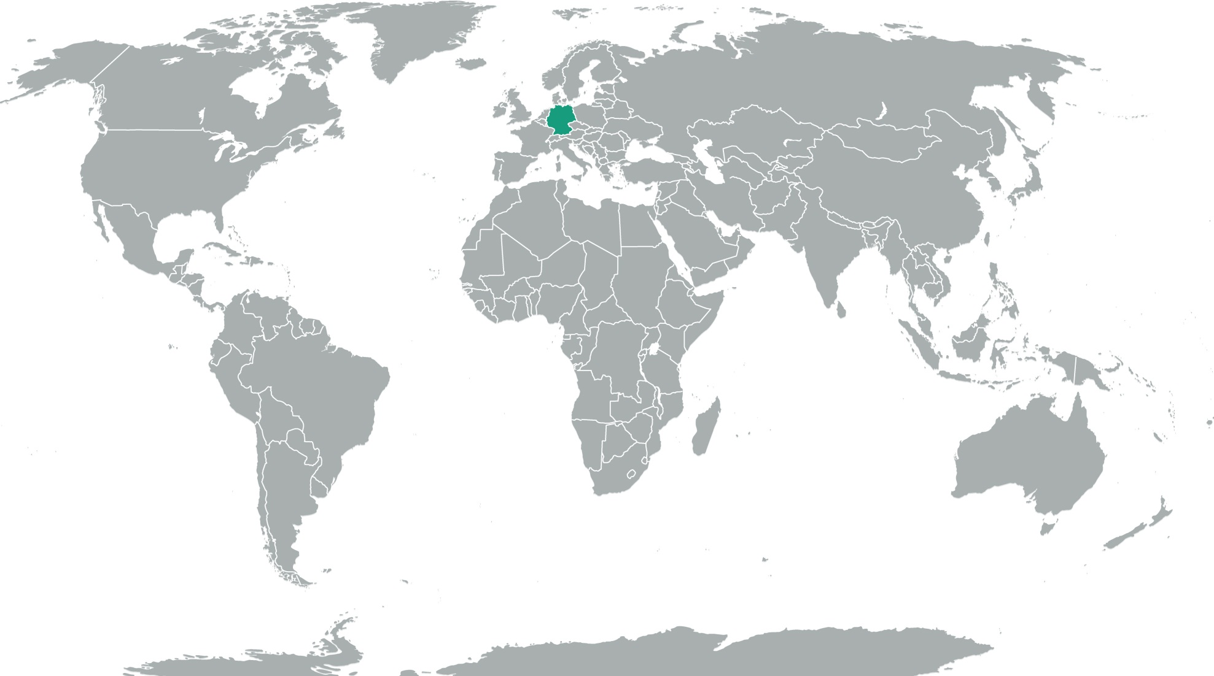
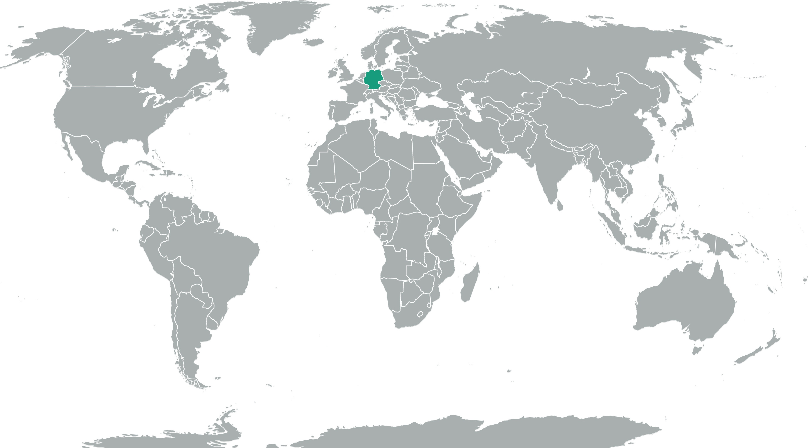
Fraunhofer worldwide
Glasgow
Gothenburg
Brussels
Wrocław
Paris
Vienna
Budapest
London
Bolzano
Graz
San José
East Lansing
Boston
Porto
Beijing
Seoul
Sendai
Plymouth
Cambridge
Thessaloniki
Newark
Tokyo
Maryland
Cairo
Dubai
Bangalore
Selangor
Singapore
Salvador
Jakarta
Campinas
Sao Paulo
Santiago de Chile
Sydney
Subsidiary
Project Center/ Strategic Cooperation
Center
Representative Office
Senior Advisor

Slide 5
Role of Fraunhofer within the innovation system
Societal challenge as future markets - being ready for global competition
Research cycle
Innovation cycle
Universities
perform excellent scientific research
RTOs bridge the innovation gap with technological R&D
Innovative
companies create
new products
Intensive exchange with society
The Management model of Fraunhofer is driven by the intermediary position between science and industry
The Fraunhofer management model needs to foster
  demand driven thinking (close contact to industry)
  ideas and fundamental research (close contact to universities)
  thinking in networks (making new connections)
  thinking in system approaches (Life cycle analysis etc)
Notes:
Message:
A systems approach need to integrate scientific research, technological R&D and innovative companies - RTOs focus on the closure of the innovation gap
-> network R&D acteurs along the value chain of R&D, integrate societal demand and acceptance, align challenges with lead markets
Fraunhofer focus in management model (einzelne Zeilen animiert!):
- demand driven thinking in close alignment with industry as our prime customer (example innovation cluster and intelligent networking)
- ideas and creativity (example future topics; also internal programmes as structural source of ideas)
- utilizing network capacity (within Fraunhofer Internal Programmes, in Spin-off ecosystem or also in international networks)
- system approaches (example electromobility - nobody has a similar potential as Fraunhofer with its wide portfolio)

Slide 6
Technology Foresight as Part of FhG Strategy
Perspectives for Future Markets
Fraunhofer Frontline Themes
Markets for
tomorrow
Global Megatrends
Grand societal challenges
1. consultation:
Fh-leaders
170 topics
Foresight analyses and trend studies
Technology based
problem solutions
50 Technology-
trends
2. consultation: Topic-ranking
Mapping
Fh-competences
Workshop with
>50 experts
Expert interviews:
25 Focus-topics
Fraunhofer-
internal process
Perspec-tives (FIT)
Future
Topics
Tomorrow
Markets
12
5
12
2004
2005
2007
2008
2010
2011

Slide 7

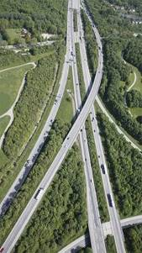
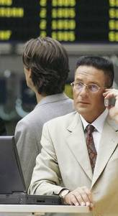
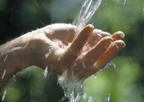
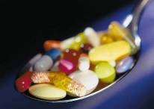
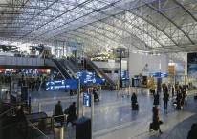
What lies ahead ?
Which Topics will transform Society?
Energy
Mobility
Environment
Health
Communications
Security

Slide 8
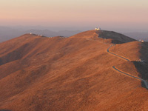
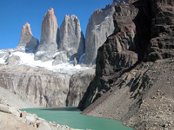
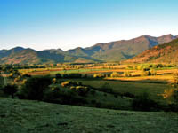
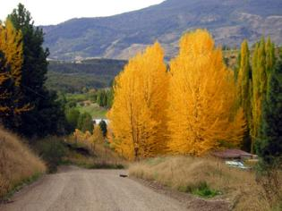
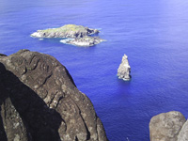

THE FRAUNHOFER MODEL
Fraunhofer is an application-oriented research organization
Long-term support from German Government
Close collaboration with industry/government
  Via contract research
Strong focus on SMEs as well as medium sized companies
Scientific excellence
  Key to competitiveness
Close collaboration with Universities
Financing Model – basics
  33% base funding from State, 33% from public competitions, 33% from industry contracts
  Now more like 20% base funding, 40% public competitions, 40% industry funding e.g 80% from contract research
Industry revenue as key KPI

Slide 9
THE FRAUNHOFER MODEL
Wide regional distribution of Institutes within Germany focused on regional industry needs
Technology licensing as core business model (mp3)
Additional value creation via spin-offs
  Fraunhofer generated over 200 spin-offs in 10 years
  Looking for key opportunities to create significant value
Contribution to economic growth and competitiveness of German industry
  About €3bil annual wealth creation from licensing
  Creation of highly skilled jobs within Fraunhofer as well as industry
  Total impact much larger

Slide 10
THE HISTORY OF FRAUNHOFER
1949 founded in Munich
  Support fund raising for industrial project in mining, iron and steel, and mechanincal engineering
  Head also was Professor at Munich University
1952 recogntion as third pillar of German science infrastructure (DFG and MPI)
1954 First Institute established in 1954 with support from Laender: Applied Microscopy, Photography and Cinematography
1955 Fraunhofer Patent Center established; subsequently many more Institutes created for industrial standards and applied research
1956 Defense projects established
1958 first Institute hived off (shoe manufacture)
1965 German Science Council recommends FhG as umbrella organization for applied research

Slide 11
THE HISTORY OF FRAUNHOFER
1972 Fraunhofer Model established
  Government base funding as a function of success at acquiring contract research, i.e. R&D with strong focus on market needs
1973 Fraunhofer Model accepted by German cabinet
1974 Focus on SMEs established
1978 Joseph von Fraunhofer Prize established
1980 First Fraunhofer Institute closed
1989 EARCO founded
1991 10 Institute from the GDR integrated
1993 Budget over 1 Bil DM
1993 Criteria tightened for Fraunhofer Institutes
1994 Fraunhofer USA established
1995 Fraunhofer Application Centres established
1997 6 Fraunhofer Institutes formed first Alliance

Slide 12
THE HISTORY OF FRAUNHOFER
1997 Prototyping and short run manufacturing introduced
2000 Executive Board expanded to 4
2001 Fraunhofer IME established
2003 12 subject areas identified with major future market potential
2005 ´Signposts for tomorrow´s markets´ published from strategic technology foresight activities
2006 High Tech Strategy introduced by German Government
  Prof. Bullinger and Dr. Oetker joint Chairmen
2008 Six Mega Trends identified
2010 Fraunhofer Chile Research Foundation established as an hub for Latin America

Slide 13
Fraunhofer Chile Research
The only legal representation Fraunhofer in Latam
Aim is to bring the Fraunhofer model to Chile and Latam
2011 Center for Systems Biotechnology (FCR-CSB) is the first Center, financed by CORFO (ICE 1.0, 10 years)
Close collaboration with Fraunhofer IME, Aachen
Model also has close collaboration with local Universities
2012 initiated collaboration with Fraunhofer FOKUS in Smart Cities Technologies
2013 established new Center for Solar Energy Technologies (FCR-CSET) collaboration with Fraunhofer ISE financed by CORFO (ICE 2.0, 8 years)

Slide 14
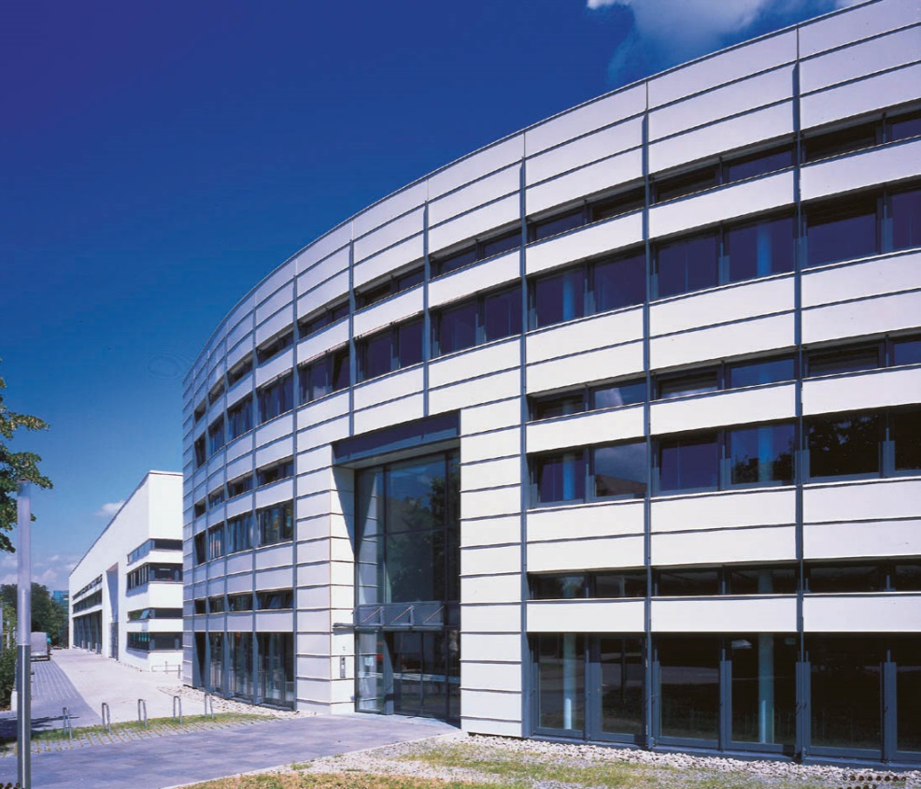
Business Areas of Fraunhofer ISE
Energy Efficient Buildings
Applied Optics and Functional Surfaces
Solar Thermal Technology
Silicon Photovoltaics
Photovoltaic Modules and Systems
Alternative Photovoltaic Technologies
Renewable Power Supply
Hydrogen Technology

Slide 15
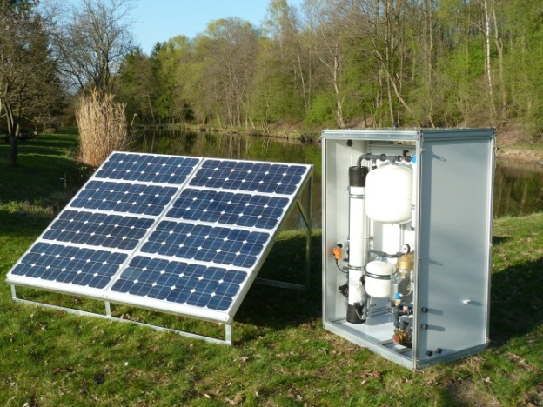
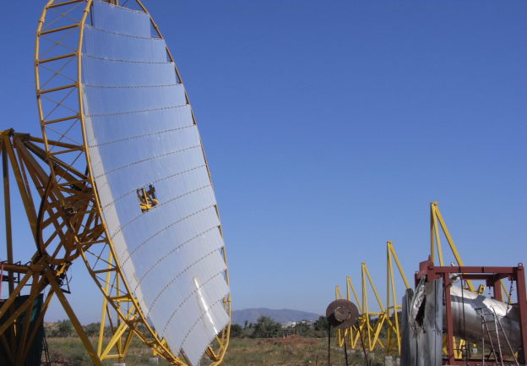
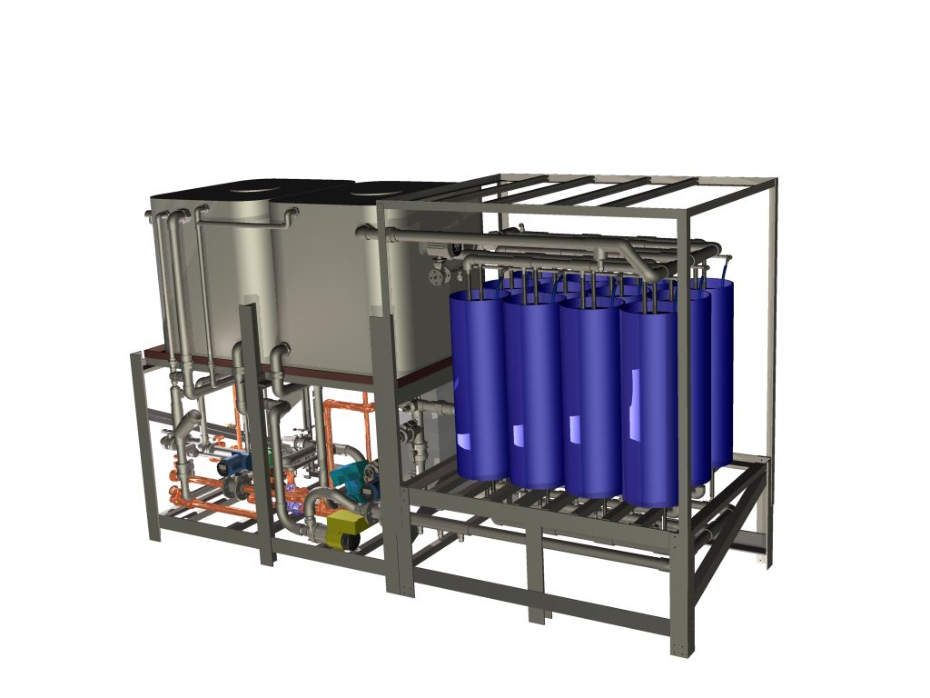
FCR-CSET
Second FCR International Centre of Excellence in Chile
Collaboration with PUC
Establishment just beginning
  Solar Energy Generation
    Concentrator technologies, CSP and CPV
  Solar Process Heat
    Solar heat for mining
    Solar cooling for food industry
    Polygeneration
  Solar Water treatment
    Desalination
  System Modelling

Slide 16

FCR InnoCity
In October 2012 established as a Hub for Smart Cities Technologies for Chile and Latam.
Present Projects in:
  Smart Electricity
  Smart Mobility
  Connectivity
  eHealth
  M2M

Slide 17
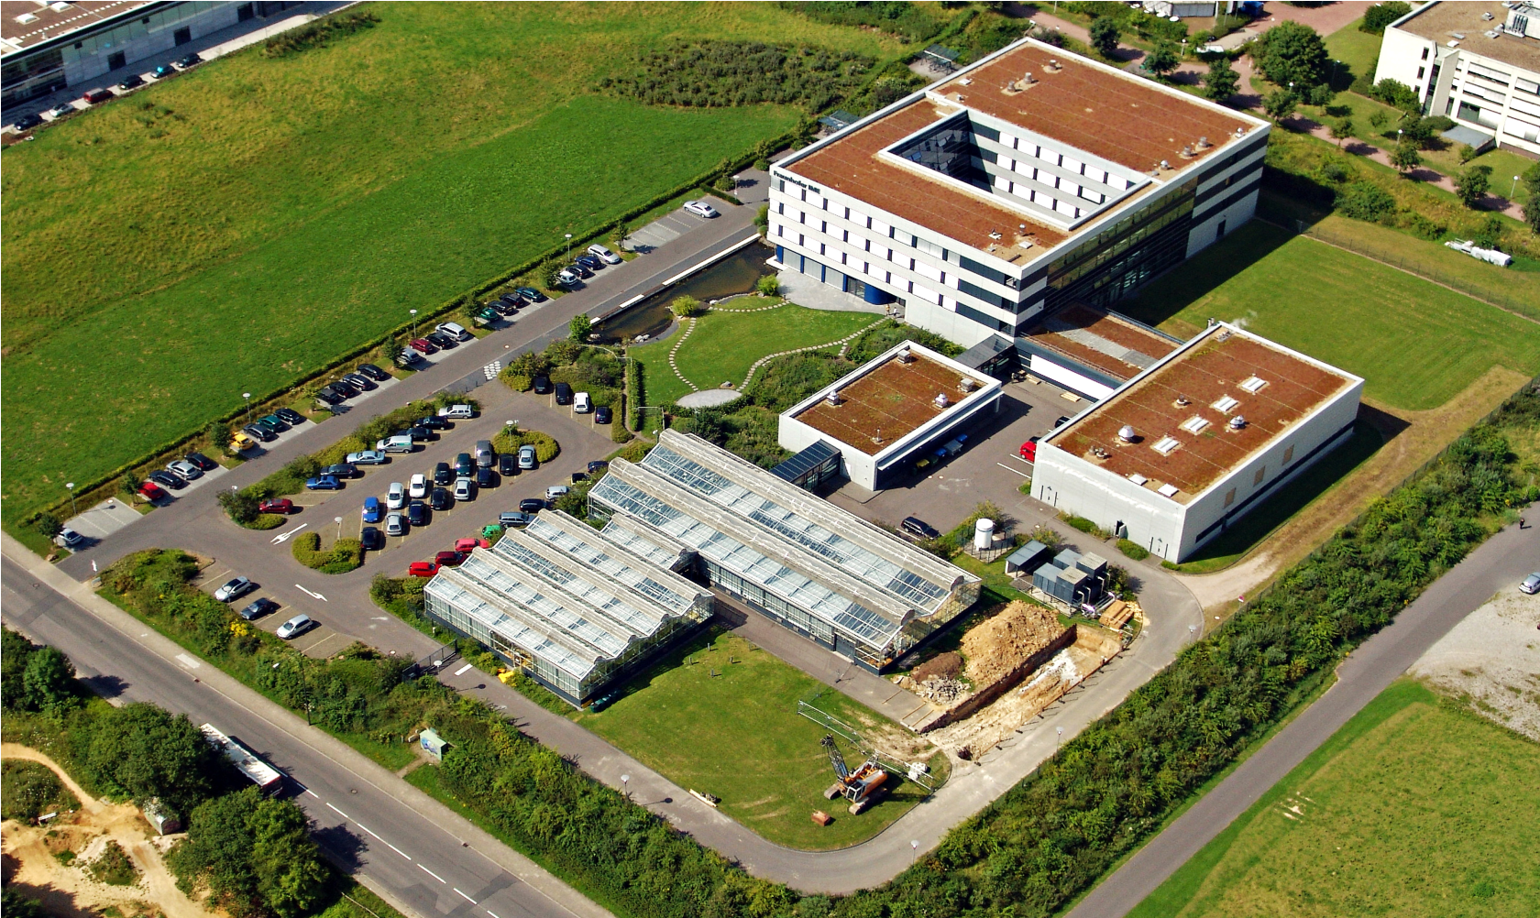
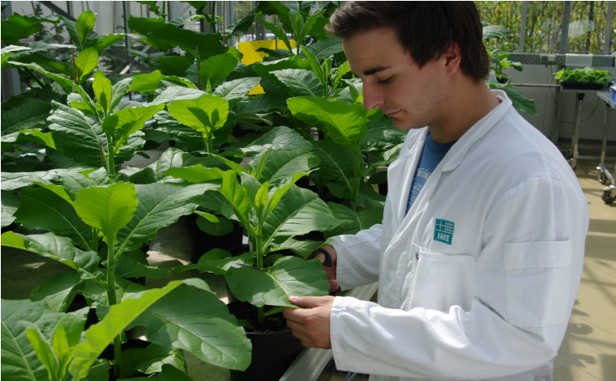
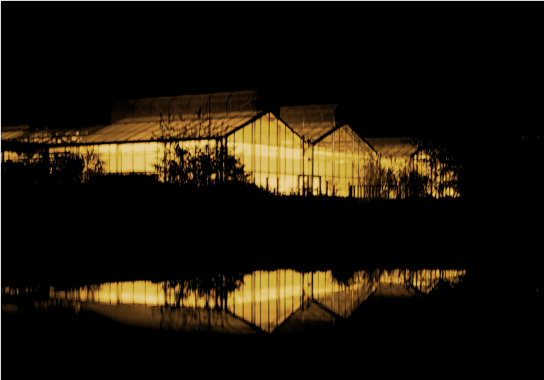
Fraunhofer IME in Aachen
Avia-Luftbild, Aachen – Dipl.-Ing. Martin Jochum

Slide 18
FCR-CSB
Foundation established in 2010
Stage 1 operations started in January 2011
  First International Centre of Excellence in Chile
Collaboration with U Talca, PUCV and Fundación Chile
  Extended to include UNAB in base program
  Now collaborations with several other Universities
At present 114 people employed in the Centre
  82 from core funding
  32 from new contracts
6 patent applications filed , 2 more being filed this month
Negotiations with 4 companies about new product introduction from research in Chile for global markets
Moved to Stage 2 after evaluation by CORFO in 2013

Slide 19
FCR-CSB
Financing from CORFO
  100% for first three years
  50% for next 7 years
Started filling the gap three month after arrival
Applied for over 50 grants since June 2011
24 new public contracts: value MUS$6.4
20 contracts with industry: value MUS$1.7
  Discussions for contracts under way
Expect long term funding from Chilean government based on success of establishment of Fraunhofer Model

Slide 20
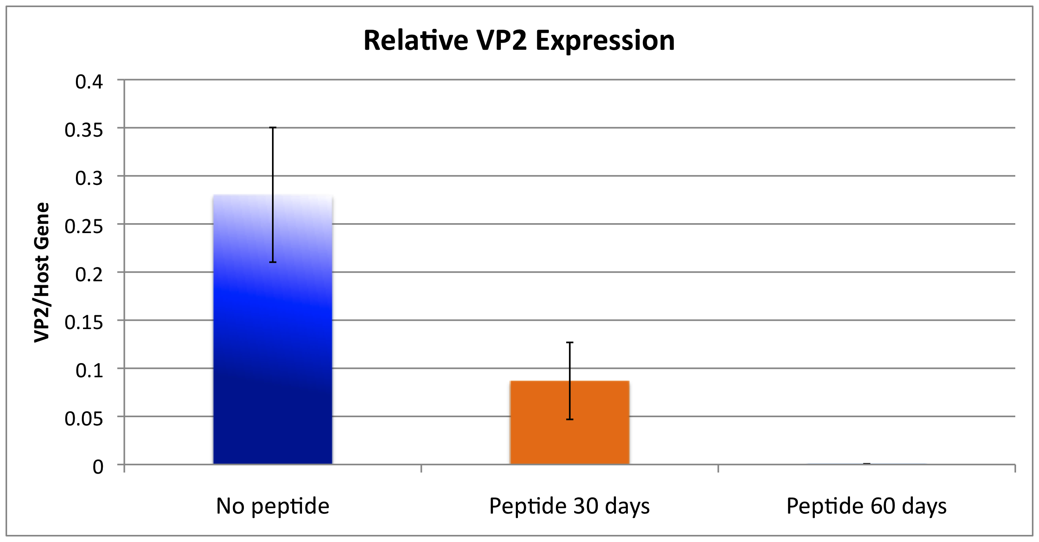
FCR-CSB
Research Portfolio – Blue Biotechnology
  Aquaculture
  Alex Brown, Mauricio Rios at FC
    ISAv Vaccine improvement
    Biomarkers for vaccine efficacy assessment
    Development of novel Caligus control agents
    Development of Sustainable aquaculture systems
  Therapeutic Peptides
  Sergio Marshal at PUCV
    Peptides for the control of aquaculture pests
    Peptides for the control of animal diseases
    Scale up of peptide production
    SRS control strategies
CONTROL OF IPNV

Slide 21
FCR-CSB
Research Portfolio – Nanotechnology
  Nanotechnology for Agriculture and Industry
  Leonardo Santos, at U Talca
    Identifying targets for industrial applications
    Molecular modelling to identify suitable nanoploymers
    Improving synthesis of dendrimers
    Removing unwanted chemicals in liquids and foods
    Nano-detoxification
    Toxicology of nanopolymers
    Analytical services
Research Portfolio- Agriculture
  Agriculture: Pollination Research
  Marnix Dorn
    Developing Best Practices for pollination
    Value added products from honey and propolis
Pesticide binding by dendrimers

Slide 22
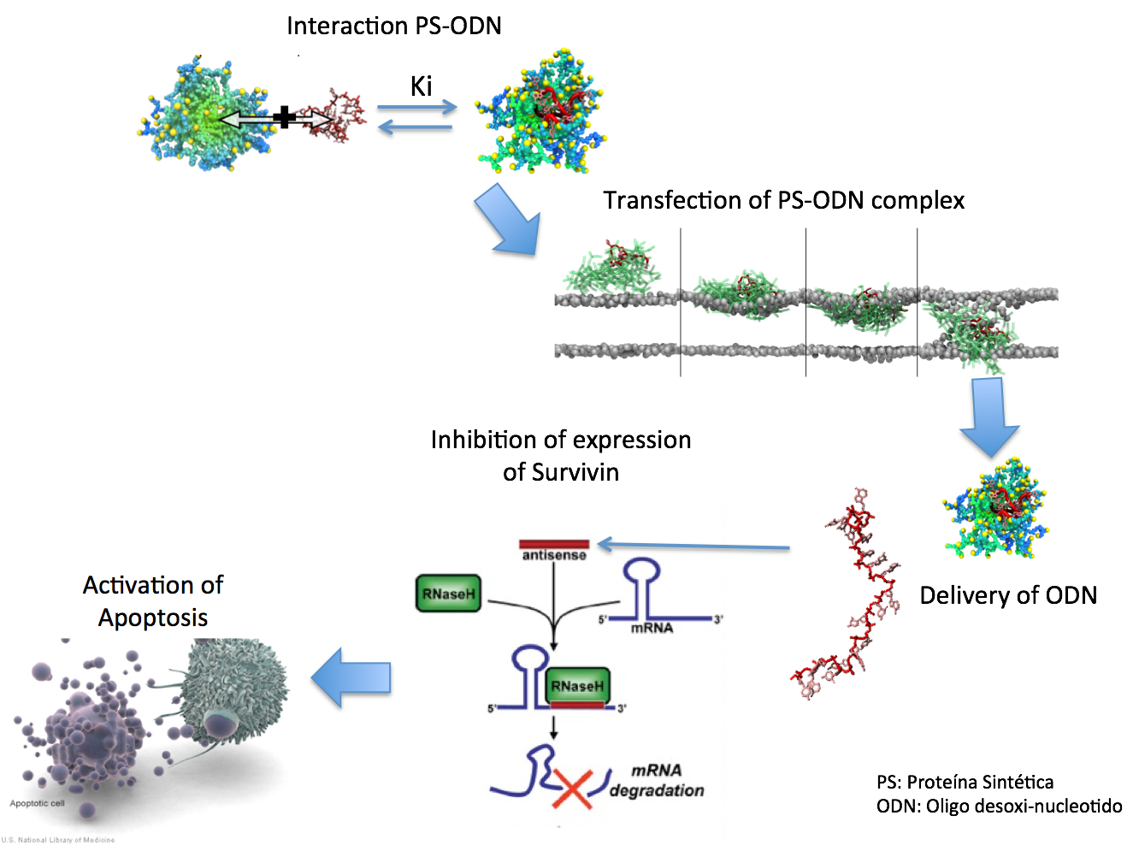
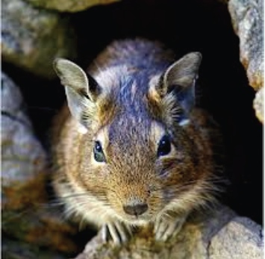
FCR-CSB
Research Portfolio – Nanotechnology
  Nanotechnology for Medicine
  Danilo Gonzales at UNAB
    Optimization of Synthetic Peptides
    Other drug delivery approaches
    New drug development
Research Portfolio – Biomedicine
  Bio-Medicine
  Patricia Cogram
  Drug testing services forpharmaceutical companies
  Drug development for neurodegenerative diseases

Slide 23
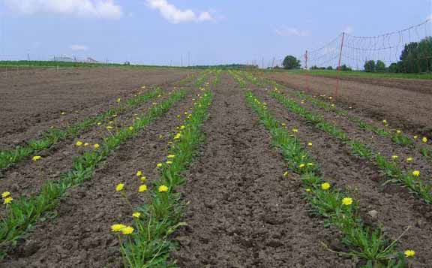
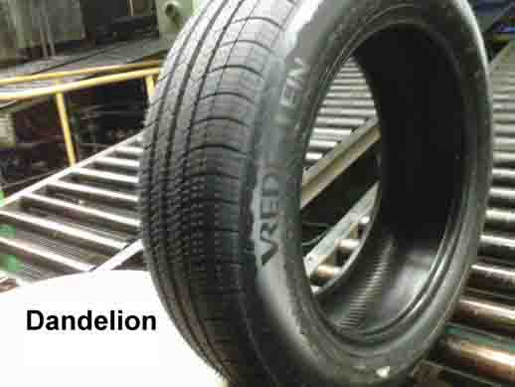
FCR-CSB
Research Portfolio
  Renewable Resoures – Food/Feed Ingredients
  Rolando Chamy at PUCV
    Identifying targets for industial applications
    Development of a business platform
    Scaling oil extraction from jatropha
    Extracting value- added compounds from plants and microalgae
    Deelopment of industrial extraction platforms
    Bioconversions for industrial uses
    Scaling all processes
    Innovation Management

Slide 24
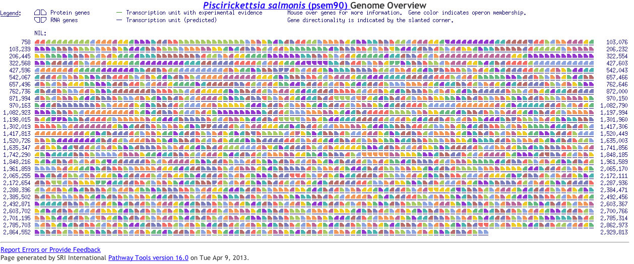
FCR-CSB
Research Portfolio – Biotechnology
  Bio-computing and Applied Genetics
  Jorge Valdes
    New search algorithm development
    Accelerated new variety generation for forestry and agriculture
    Biomonitoring
    Fungal synthetic biology

Slide 25
Strategic Approaches to Innovation
Basic
Research
Late
Research
Initial
Launch
Early
Product
Concept
Product
development
Discovery of new concepts
Research into basic mechanisms
Proof of concept development
Patent filing
Work with Industry Partners
Scale up
First Prototype
Patent work
Prototype
Prototype refinement
Scale up
First small scale product sales
University
FCR
FCR / Industry
Industry/FCR
Industry

Slide 26
COMMERCIAL SUCCESS STORIES
  Control of IPNv in salmon
    Discussions with a company to register new product in Chile
  Nanoparticles for removal of pesticide residues
    Discussions with a company for commercial development
  Nanoparticles for wine improvement
    Discussions with a company for application to stop pinking in white wine
  Nanoparticles for gene delivery
    Discussions with a company for drug efficay improvements

Slide 27
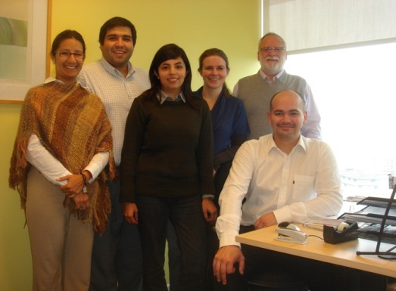
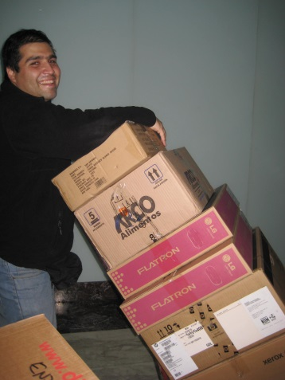
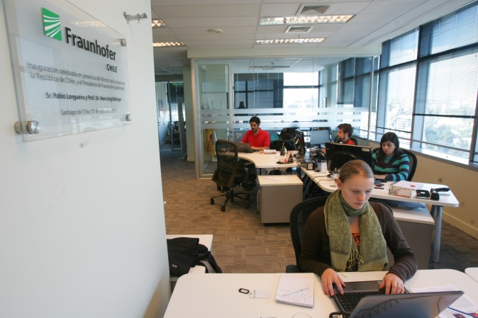
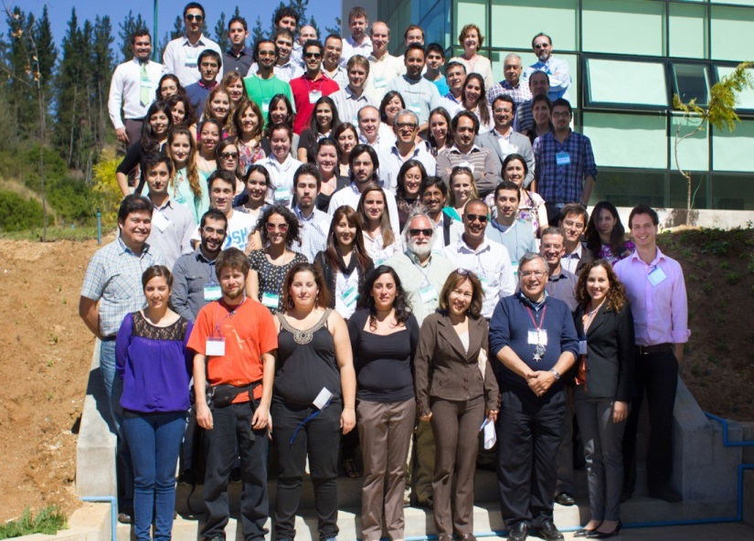
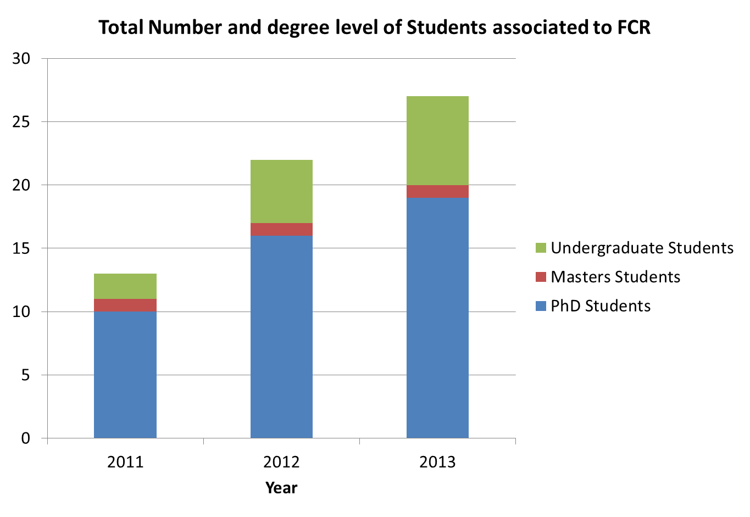
CAPACITY BUILDING
Graduation Dates
In 2013: 1
In 2014: 8
In 2015: 7
In 2016: 3

Slide 28
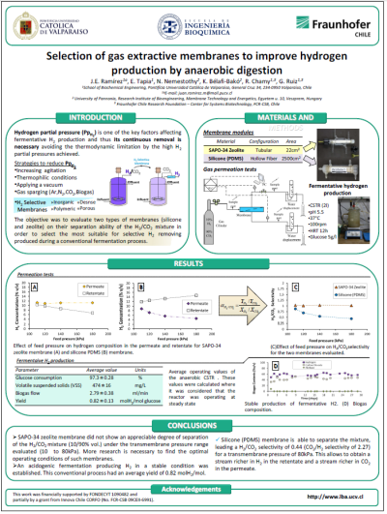
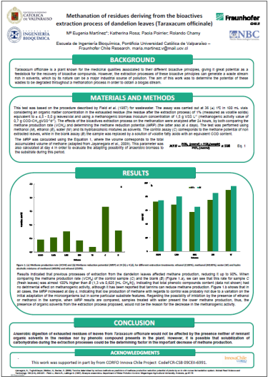
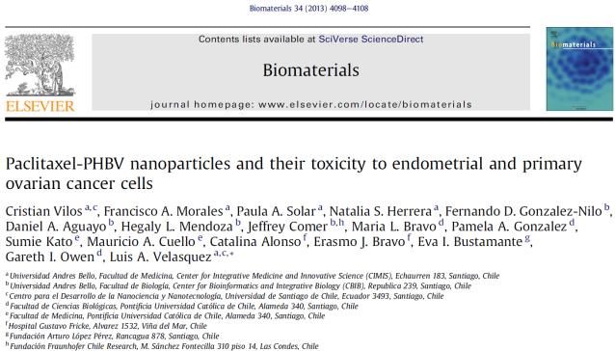
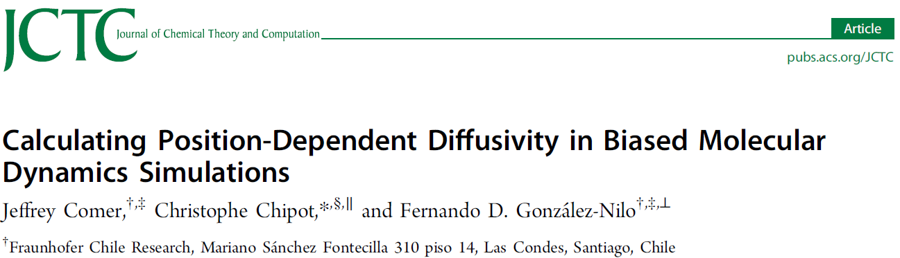
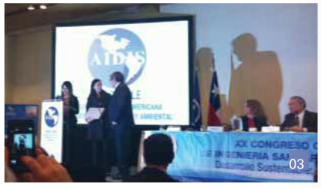
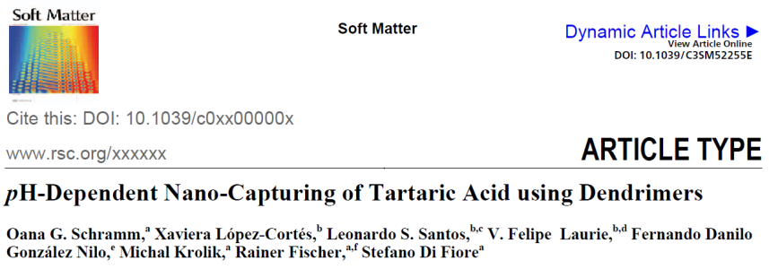
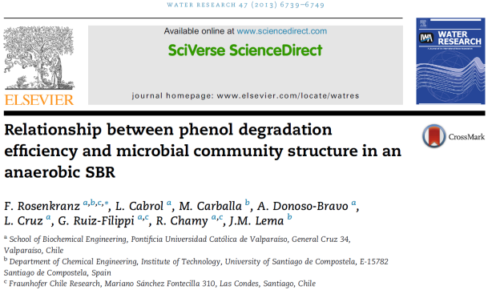
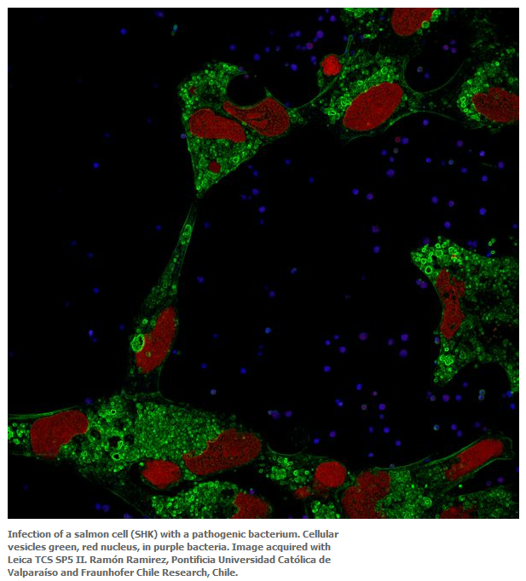
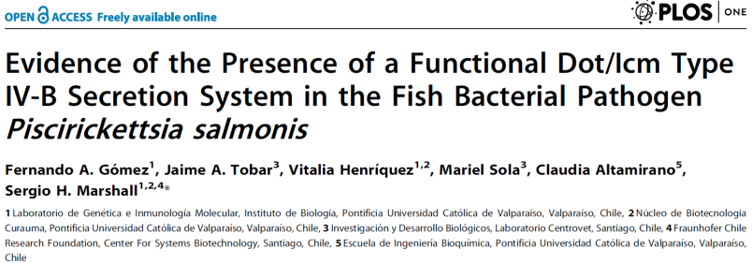
SCIENTIFIC EXCELLENCE
Type of Publication | Number
Papers in peer reviewed journals | 21
Highest impact factor (Biomaterials) | 7.6
Oral presentations at scientific meetings | 29
Posters at International meetings | 25
Posters at National meetings | 12
Awards for posters /presentations | 4
Joint Papers with IME | 1

Slide 29
Training
Professional Training (596 training days)
  Good laboratory practice workshop (all FCR-CSB members)
  Advanced IP training (1 FCR-CSB member)
  IP workshops (all FCR-CSB members)
  Project management workshops (All project leaders)
Scientific Training (2499 training days)
  Attendance at scientific meetings, seminars, workshops
  A total of 106 meetings attended
Co-organization of scientific meetings and workshops
  10 meetings and workshops co-organised
Scientific exchange meeting of all FCR-CSB staff
  80 members participated in one day event
  Second event being planned

Slide 30
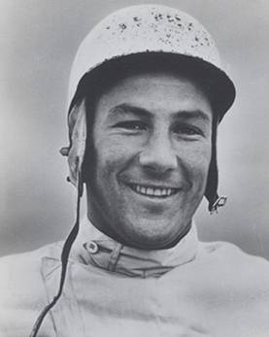
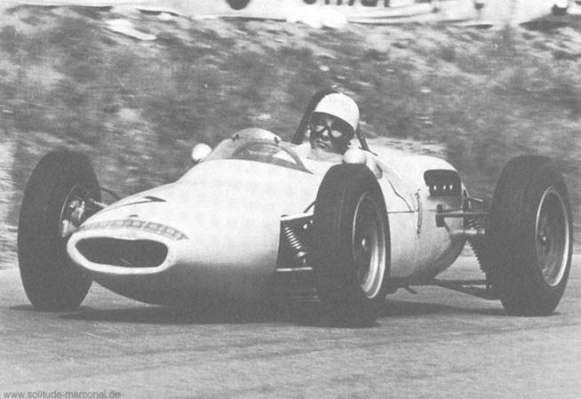
If everything is under control you are just not driving
fast enough.
Stirling Moss
(automobile racer,
born 1929)

Slide 31
SUMMARY
FCR- CSB has made an impact in Chile
  Strong player in the Biotechnologies
  Established an extensive network of collaborations with new players
  Public recognition
Excellence in science is strong driver
IP development is key
Proven Technology Transfer Model
Excellent employer
CORFO base funding was key to achievements

Slide 32

Contact Details
Wolfgang Schuch
Executive Secretary
Fraunhofer Chile Research Foundation
Center for Systems Biotechnology
Sánchez Fontecilla 310, Piso 14
Las Condes, Santiago, Chile
Wolfgang.schuch@fraunhofer.cl
56 96 597 9364

